Slide 1
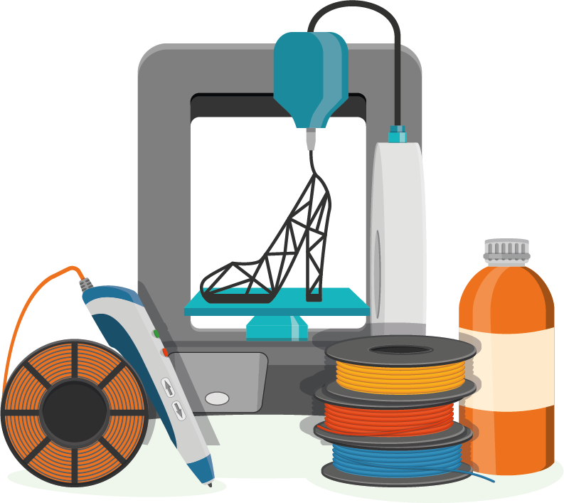
Material Extrusion
Learning Unit 1: 3D Material Extrusion (MEX) Overview

Slide 2
Content
01
02
03
04
Introduction
MEX Process Overview
Overview on Polymer Materials, their properties and applications
Conclusion

Slide 3
Learning Outcomes
The student will learn to:
Distinguish 3D Printing parts produced by MEX from other polymers 3D printing processes
List the advantages and limitations of MEX over other 3D Printing Polymers processes, including their applicability according to the characteristics of the process
Identify Polymer Materials for MEX AM according to the specific medical use and real-life applications
Recognize examples of MEX applications, including in the biomedical sector.

Slide 4

Introduction
In this unit the student will obtained a basic knowledge of:
Material Extrusion (MEX) process
Polymer Materials and characteristics and their effects on MEX 3D printing
Potential and limitations of Polymer MEX materials
Real life applications for MEX

Slide 5
01
MEX Process Overview

Slide 6
What is 3D Printing?
What is?
Example
3D Printing is the process of building objects by creating successive layers of a material. It creates objects by adding material layer-by-layer until completion
Think of how a house of bricks is built. 3D Printing builds objects in a similar way, starting with very small pieces of material and combining them, layer-by-layer, to form a larger finished product.

Slide 7
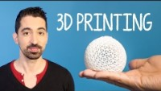

Process
You can insert a video to better explain your ideas
https://www.youtube.com/watch?v=Vx0Z6LplaMU

Slide 8
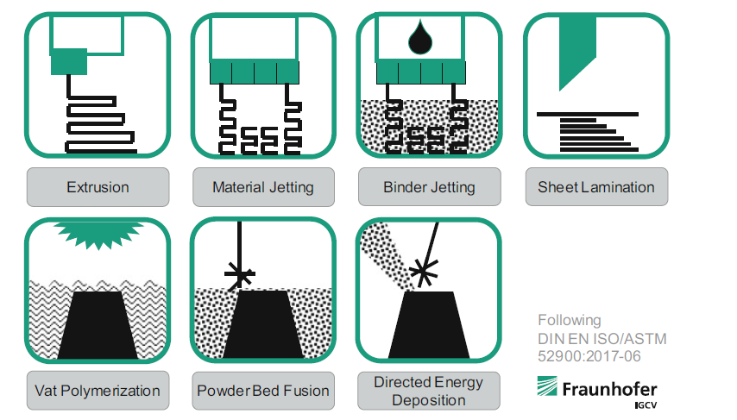
3D Printing process categories
The ISO/ASTM 52900 Standard was created in 2015 to standardize all terminology as well as classify each of the different methods of 3D printing. A total of seven process categories were established.

Slide 9
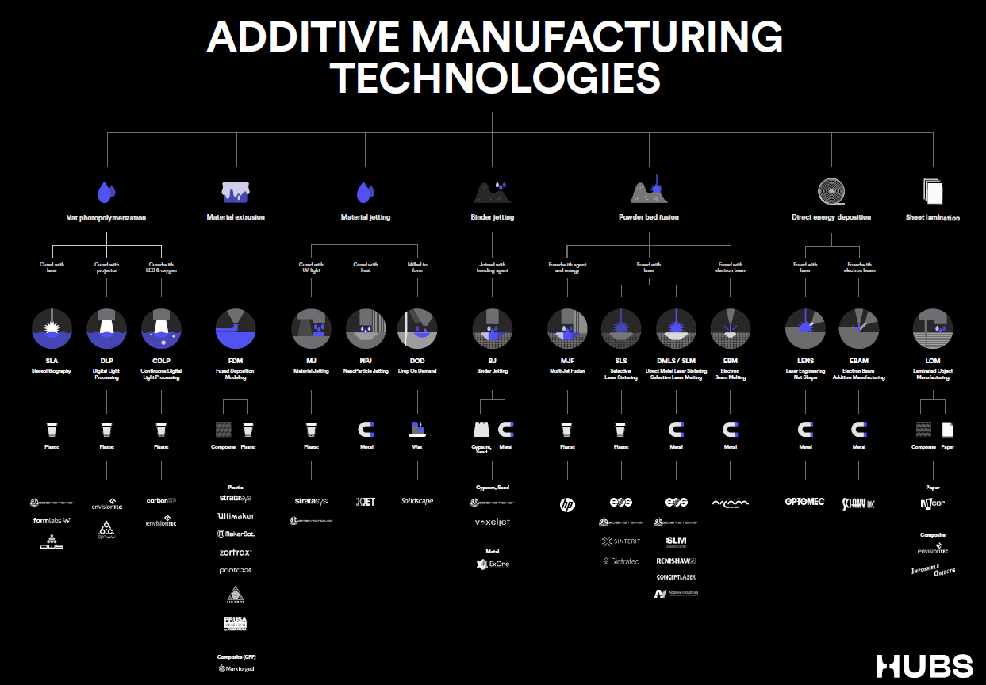

Slide 10
—Material Extrusion Process definition according to ISO/ASTM 52900
“A AM process in which material is selectively dispensed through a nozzle or orifice”

Slide 11
Material extrusion
Material extrusion produces parts by layering extrusions of molten thermoplastic filament.
A spool of filament is loaded into the printer and fed through to the extrusion head.
Once the printer nozzle has reached the desired temperature, a motor drives the filament through the heated nozzle melting it.
The printer then moves the extrusion head around, laying down melted material at a precise location, where it cools down and solidifies.
Once a layer is complete, the build platform moves down and the process repeats building up the part layer-by-layer.

Slide 12

MEX terminology
FDM
Material extrusion technology was first developed in the 1980s by S. Scott Crump under the registered name of fused deposition modeling (FDM). The term fused deposition modeling and its abbreviation FDM are trademarked by Stratasys Inc, a company co-founded by Scott Crump.
FFF
Fused filament fabrication (FFF) is another type that falls under this category developed by the members of the RepRap project which is not restricted to use by others.

Slide 13
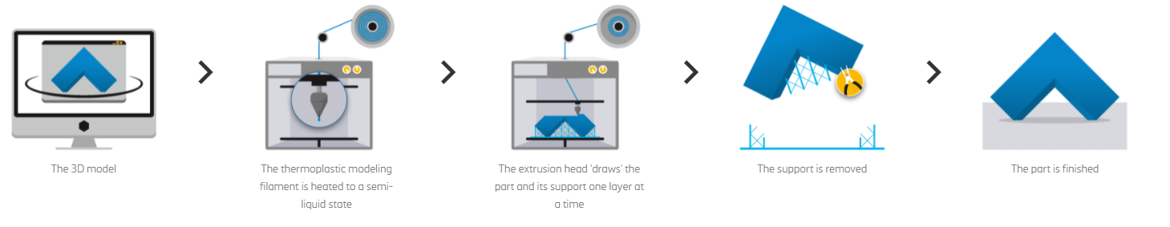
MEX process

Slide 14
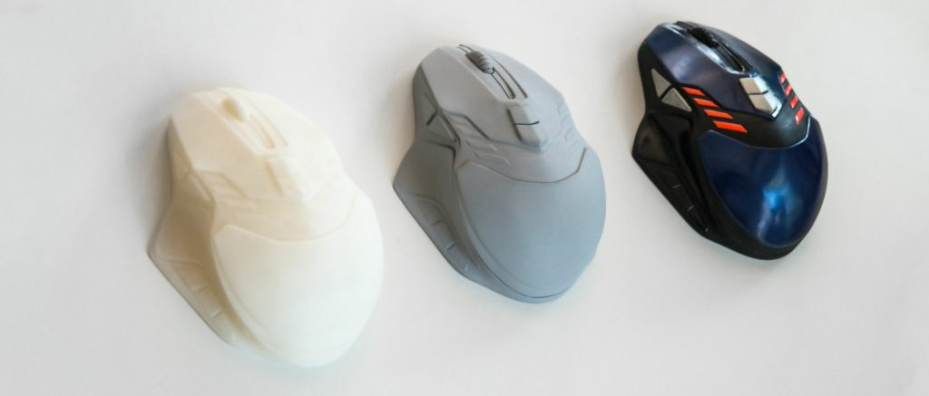
Material Extrusion parts

Slide 15
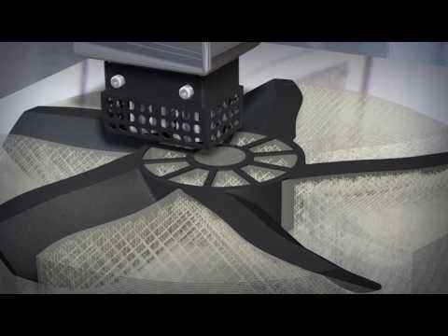
You can insert a video to better explain your ideas
https://youtu.be/UdDMJnUWVkA

Slide 16
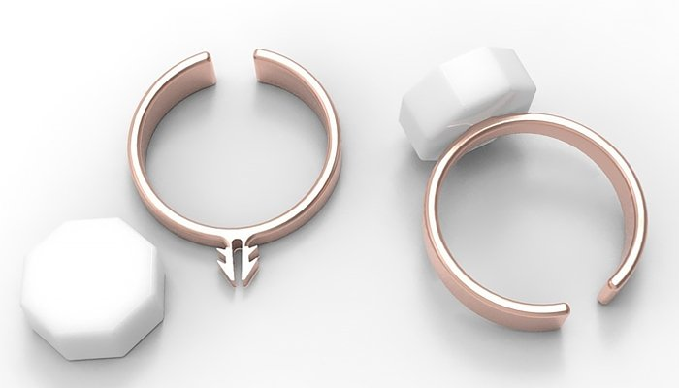
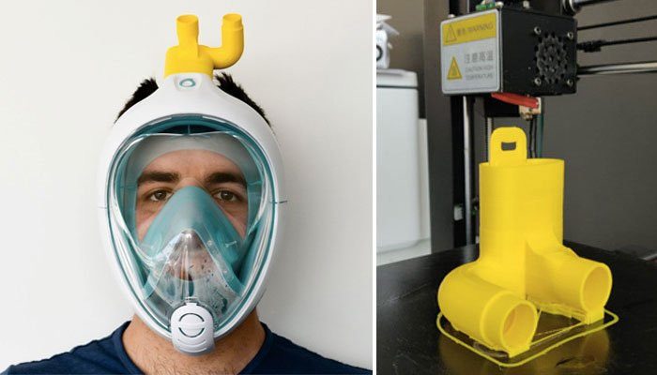
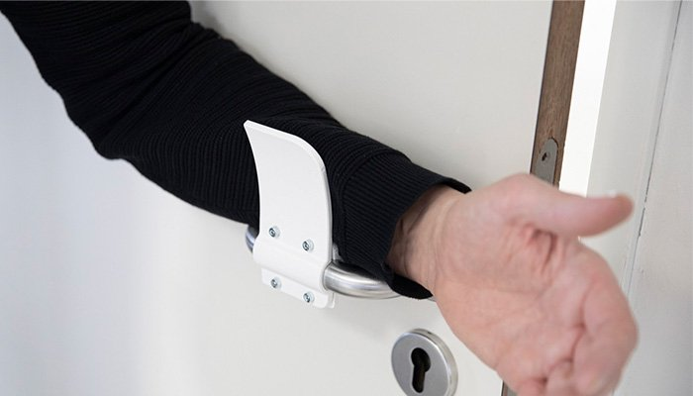
MEX examples. COVID-19
Soap ring
Decathlon snorkeling masks for hospitals
Contactless door openers

Slide 17

MEX examples. COVID-19

Slide 18
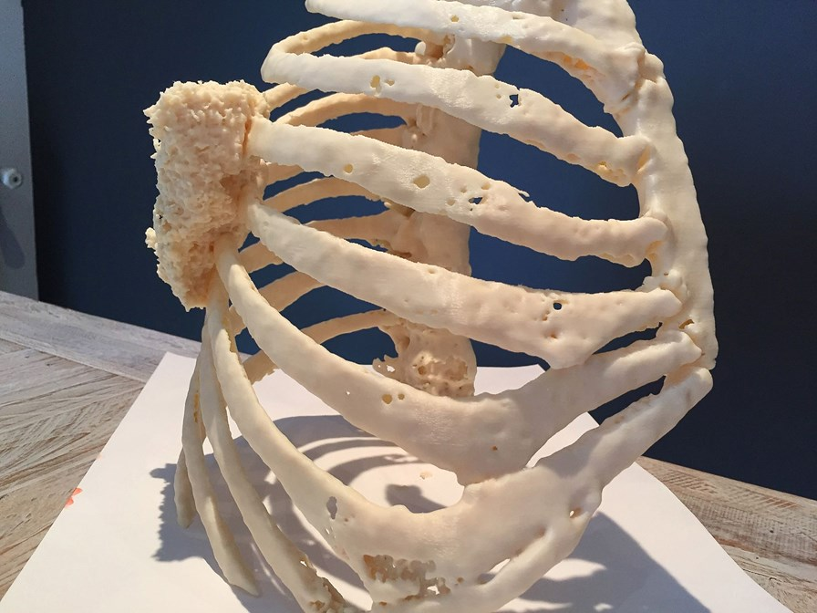
Biodonostia Health Research Institute created a precise, anatomically-accurate 3D printed model of the thoracic wall to plan and perform the resection on the 3D model ahead of the surgery with a Stratasys Fortus 450mc. This meant a significant reduction in time under anaesthesia, and for the hospital, freeing up time in operating rooms saves costs.

Slide 19
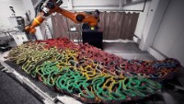
MEX examples. Art

Slide 20

SpaceX has created 3D printed space suits and helmets that can be easily replicated with desktop 3D printers. Each helmet has a visor, valves, locks and microphones, and the suits meet the requirements of space travel. The MEX method of printing the helmets has been used to manufacture this apparel, as it provides a wider range of advanced materials, such as PEKK

Slide 21

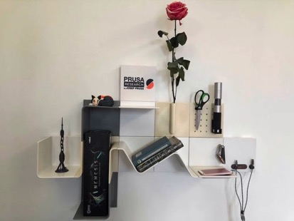
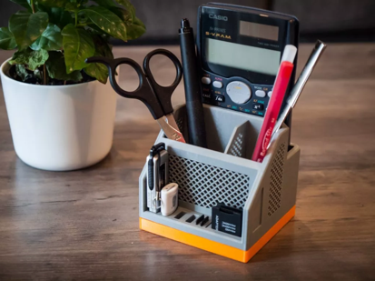
MEX examples. Consumer applications
Coffee Capsule Dispenser
Modular Shelf
Desktop Organiser

Slide 22
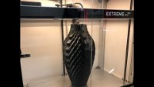
MEX examples. Consumer applications

Slide 23
—Powder Bed Fusion Process definition according to ISO/ASTM 52900
“Additive manufacturing process in
which thermal energy selectively fuses regions of a powder bed”

Slide 24
Powder Bed Fusion
Powder Bed Fusion-PBF produces parts by using an energy force to selectively melt or sinter powdered particles together to form a whole object. Powdered material is heated to just below its melting point and spread over the build platform in a very fine layer. A laser or electron beam is then directed across the powder’s surface, fusing particles together to form a single cross-section of the print.
After each layer, the build platform is lowered and the process repeated. Each new layer is fused to the previous until all the layers have been fused into one object. As layers are built on top of one another, the unfused particles act as a support structure for the print, thereby eliminating the need for most separate support structures. Once the print is complete, the excess supporting powder is removed and recycled.
Lots of 3D printers use PBF technology. Many different types can print in many different materials, but the most common are selective laser sintering (SLS), direct metal laser sintering ( DMLS ), selective laser melting (SLM), HP’s multi-jet fusion ( MJF ), high speed sintering (HSS) and electron beam melting (EBM). SLS is the most common for plastics, and DMLS and SLM are the most common for metals.

Slide 25
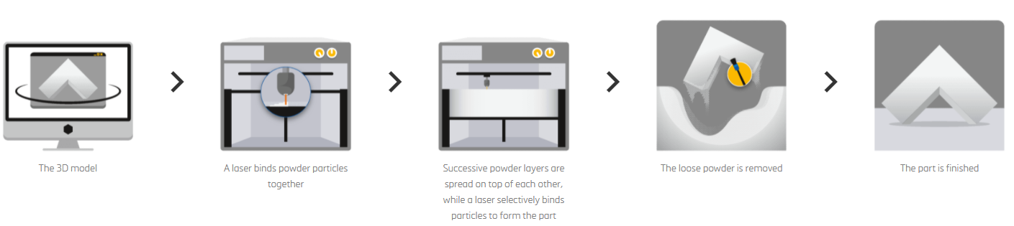
Powder Bed Fusion process (SLS)

Slide 26
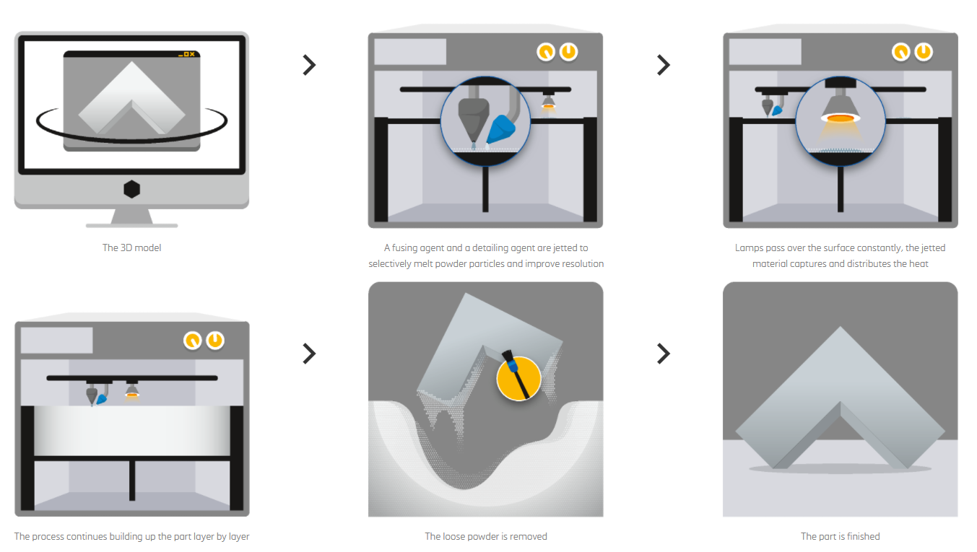
Powder Bed Fusion process (Multijet)

Slide 27
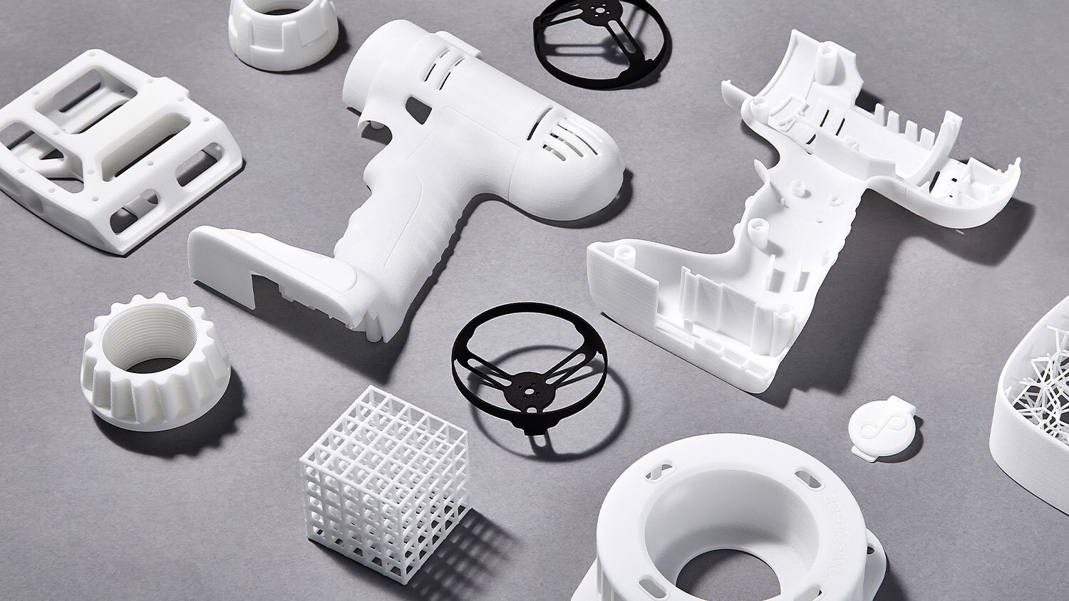
PBF parts

Slide 28
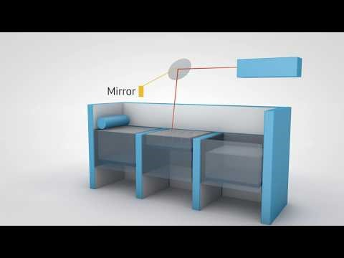
Process
You can insert a video to better explain your ideas

Slide 29
—Vat Photopolymerization Process definition according to ISO/ASTM 52900
“Additive manufacturing process in which liquid photopolymer in a vat is selectively cured by light-activated polymerization”

Slide 30
Vat Photopolymerization
Vat Photopolymerization technologies utilize a photo-polymer resin in a vat that is cured by a light source. The most common forms of Vat Photopolymerization are SLA (Stereolithography) and DLP (Direct Light Processing). Since both Vat Photopolymerization technologies use similar mechanisms to produce parts, for simplicity they will be treated equally when discussing topics like post-processing or benefits and limitations.
Stereolithography (SLA). SLA is famous for being the original 3D printing technology. The process uses mirrors, known as galvanometers or galvos, (one on the x-axis and one on the y-axis) to rapidly aim a laser beam across a vat, the print area, curing and solidifying resin as it goes along. This process breaks down the design, layer by layer, into a series of points and lines that are given to the galvos as a set of coordinates. Most SLA machines use a solid state laser to cure parts.

Slide 31
Vat Photopolymerization
Direct Light Processing (DLP). The process works by using a projector. This projector cures a photopolymer resin, one layer at a time, curing the selected areas to be solidified according to the 3D printer model and leaving the surrounding areas uncured. Once one layer has been completed, the part is pulled up by one layer height (e.g. 50 microns) and the process repeats again.
DLP is overall very similar to SLA. However, there are subtle differences. Firstly, whereas DLP uses a projector, SLA instead uses a UV laser to cure the resin. When printing, the part is still pulled out of the resin layer by layer, but with DLP the whole layer can be created in one singular digital image projection, whereas with SLA the UV laser needs to scan the selected area to trace it. This means that DLP is faster than SLA in most cases.

Slide 32
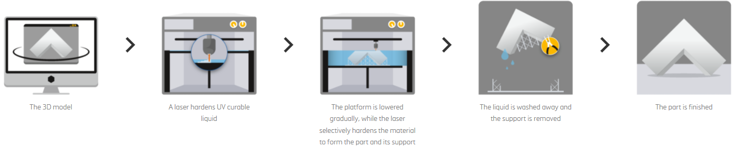
Vat Photopolymerization process (SLA)

Slide 33
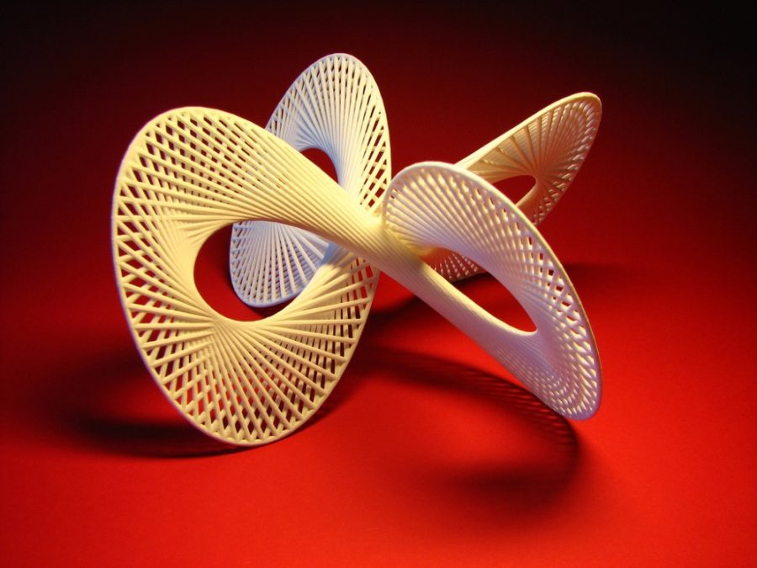
Vat Photopolymerization parts

Slide 34
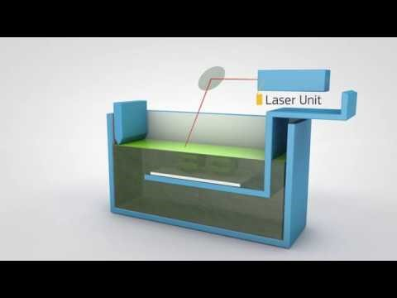
Process
You can insert a video to better explain your ideas

Slide 35
—Material Jetting Process definition according to ISO/ASTM 52900
“Additive manufacturing process in
which droplets of feedstock material are selectively deposited”

Slide 36
Material jetting
Material jetting produces parts by jetting tiny droplets of liquid material onto the build platform and solidifying them with heat or light. Much like the standard 2D ink jetting process, a printhead with hundreds of material jets moves over a build platform, depositing material along an X-axis carrier, sweeping back and forth like the windshield wipers on a car and covering one whole layer in a single pass. One printhead can carry jets for multiple materials, allowing for multi-material printing, full-color printing, and dispensing disposable support structures, such as wax.
Within the material jetting category there are a few distinct printing technologies. The three most common are PolyJet, NanoParticle Jetting (NPJ), and Drop-On Demand (DOD). PolyJet is by far the most popular.
PolyJet, the first material jetting technology, is patented and owned by Stratasys . It dispenses liquid photopolymer resin and easy-to-remove support material from the printhead, which is then cured by a UV light.

Slide 37
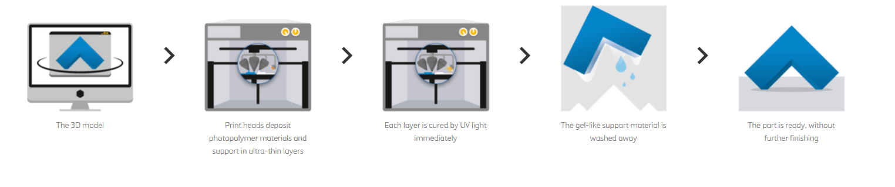
Material jetting process (Polyjet)

Slide 38
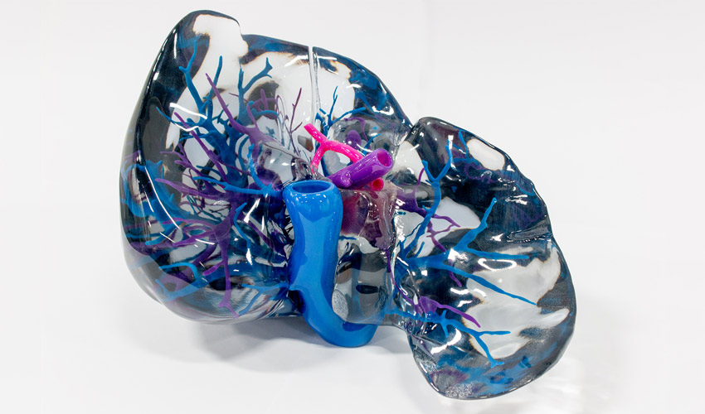
Material jetting parts

Slide 39
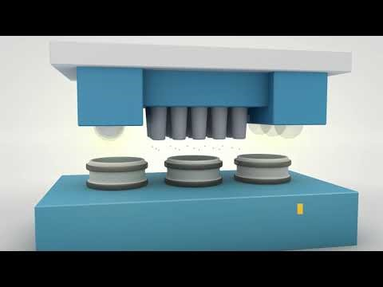
Process
You can insert a video to better explain your ideas

Slide 40
—Binder Jetting, Process definition according to ISO/ASTM 52900
“Additive manufacturing process in which a liquid bonding agent is selectively deposited to join powder materials”

Slide 41
Binder Jetting
Binder jetting produces parts by selectively depositing a binding agent over a powder bed. The build platform is first covered with a very thin layer of material powder. A printhead covered in inkjet nozzles then passes over, depositing a binding agent where the print is to be formed. Binder jetting printers can also print in color by depositing colored ink after the binding agent, before a new layer of powder covers the previous one.
Once the final layer is finished, the part is left to cure in the powder and let the binding agent gain strength. Once removed from the powder bin, some kinds of materials are ready. However, if parts are for functional use, most need to be infiltrated and sintered, causing them to shrink by up to 40 percent.

Slide 42
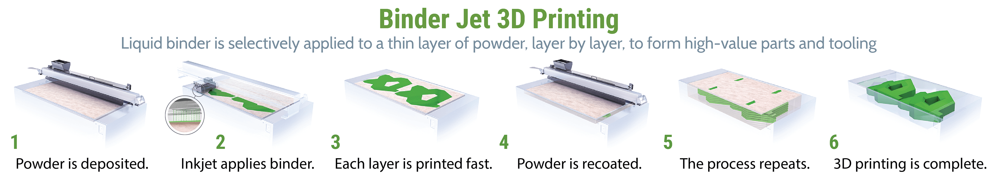
Binder Jetting process

Slide 43
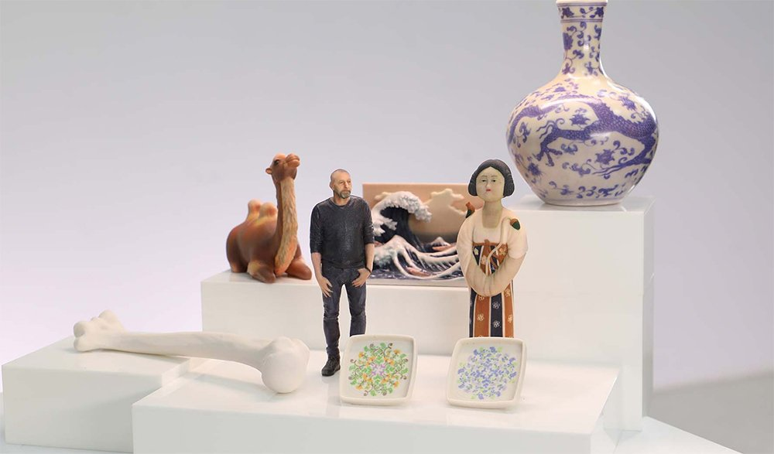
Binder jetting parts

Slide 44
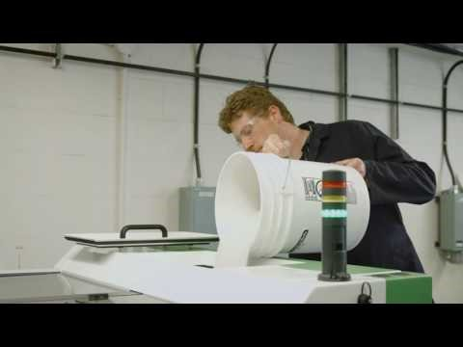
Process
You can insert a video to better explain your ideas

Slide 45

Mark the right sentence
FDM/FFF are commercial brands of Material Extrusion
Binder Jetting uses filaments
PolyJet is by far the less popular technology in Material Jetting
SLA and SLS are the same technology, but the first one is a commercial brand.

Slide 46
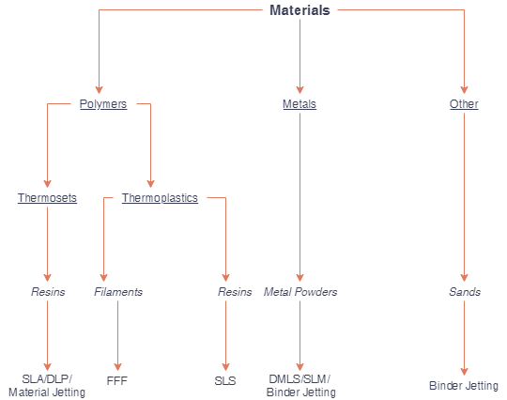
3D Printing materials
The majority of 3D Printing materials can be separated into 2 groups; polymers and metals

Slide 47
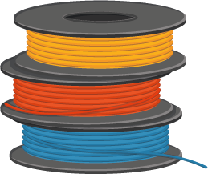
Feedstock
According to ISO/ASTM 52900:2015, feedstock is bulk raw material supplied to the additive manufacturing building process. MEX uses mainly filaments as feedstock. Polymer raw materials for MEX are made into continuous filaments after raw materials are processed into polymers and transformed into pellets.
For example, for PLA filaments, the process would begin with corn fermentation (corn to Lactic Acid), condensation (Lactide) and polymerization (Polylactic acid; PLA). After that, the material is pelletized and extruded into filaments for final use.

Slide 48



Feedstock.
MEX materials
There are many different types of materials used in 3D Printing, but along this unit, we focus mainly in three of them:
Polymers
Composites
Metal infused polymers

Slide 49
MEX materials. Polymers
Polymers come in many different forms and their diversity of properties sees them used for a wide range of applications.
Polymers are found in everything from adhesives to biomedical devices.
Today, the polymer industry is larger than the steel, aluminum and copper industries combined.
Polymers in 3D printing generally come in three different forms: filament, resin and powder.

Slide 50
MEX materials. Polymers
Categories
State
Products
Polymers in 3D printing are generally divided into two categories: thermoplastics and thermosets. They differ mainly in their thermal behavior. In MEX thermoplastics is a common material
Thermoplastics can be melted and solidified over and over again while generally retaining their properties.
Common thermoplastic products include plastic bottles, LEGO bricks and food packaging.

Slide 51
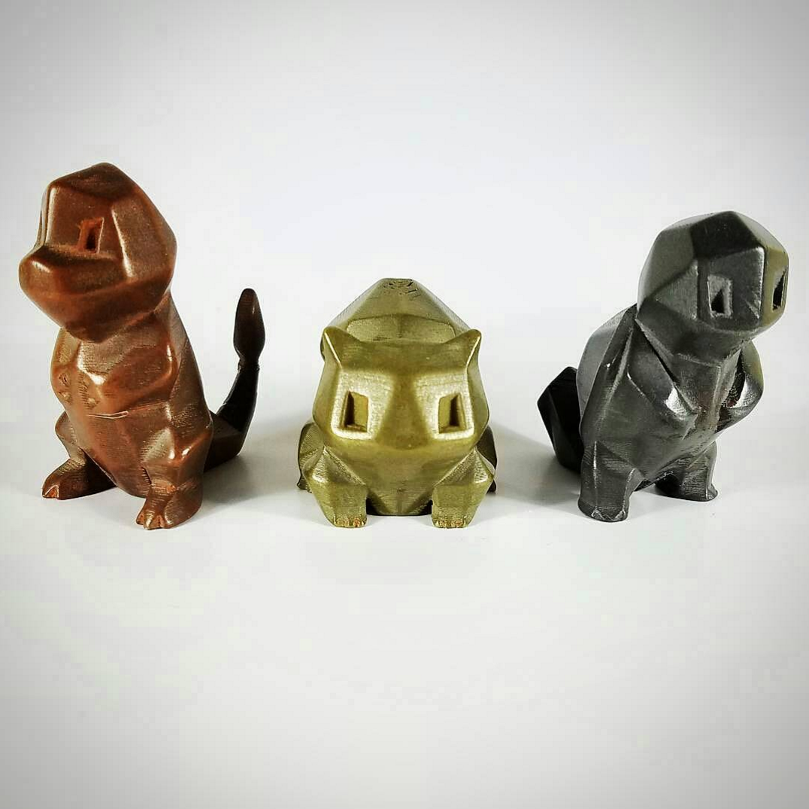
MEX materials. Metal infused polymers
Metal infused polymers
Metal 3D printing filament is basically normal filament with some amount of metal added. That means it can be used with a regular desktop MEX printer, possibly with a special nozzle. Metal filaments come in a variety of materials, ranging from copper and bronze to iron and stainless steel. Metal filament prints can feel more solid and look similar to cast metal.

Slide 52
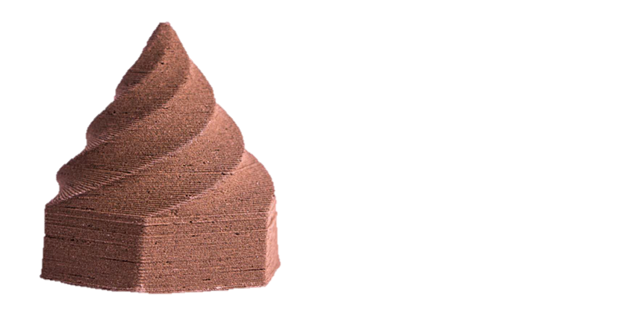
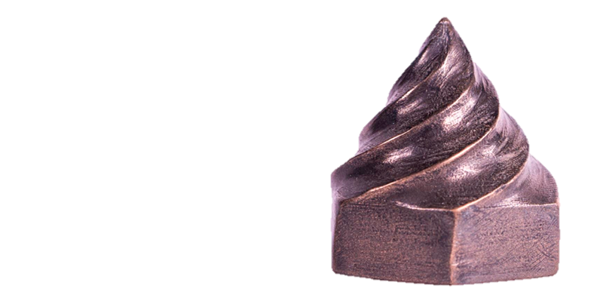
MEX materials. Metal infused polymers
Metal infused polymers
It could be confusing because sometimes there is only “metal” in the name, as this might simply indicate a metallic color or shine. For example, Amolen’s Multicolor Silk Metal Rainbow is meant to exhibit a “metallic color.” Also know that, though a manufacturer may list the percentage of metal that’s in its filament, this could be by either volume or weight, making comparing materials difficult; the latter tends to look more impressive, as metal is much denser than plastic.
3D printed part with Filament Copper and part after sintering. Source: The Virtual Foundry.

Slide 53
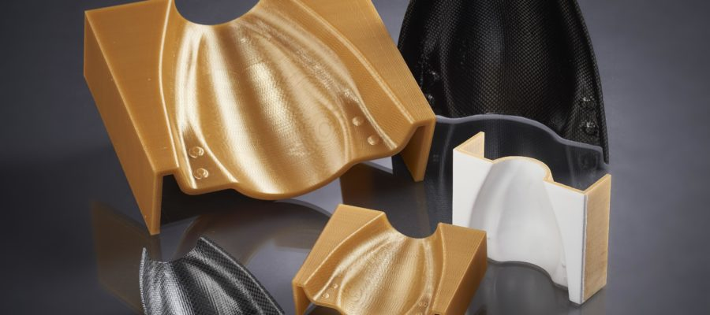
MEX materials. Composites
Composites
Some 3D printing technologies make use of ceramics (typically a polymer filled with ceramic powder) or composites (chopped carbonfilled filaments or metal-nylon powder).
Composites will be commented with more details along this unit.

Slide 54
MEX characteristics
Printer parameters
There are many parameters that can be adjusted on most MEX machines to achieve an accurate print. Build speed, extrusion speed and nozzle temperature control the consistency of the extruded filament and are set by the operator (some machines use automatic presets based on the type of material that is being printed).
At a fundamental level, nozzle diameter and layer height define the resolution of an MEX printed part. While all parameters define the dimensional accuracy of a part, a smaller nozzle diameter and lower layer height are generally seen as the solutions for parts where a smooth surface and higher level of detail is required.

Slide 55
MEX characteristics
Technical Specifications for MEX
Standard lead time: Depend on size of the part, number of parts and degrees of finishing.
Accuracy: ± 0.15% (together with lower limitation on ± 0.2 mm)
Thickness of layer: 0.18 – 0.25 mm (varies according to depending on the material)
Minimum thickness of wall: 1 mm
Maximum dimensions of build: Unlimited Dimensions as parts may be composed of the number of sub-parts. The maximum build envelope is 914 x 610 x 914 mm
Surface structure: A rough surface of unfinished parts but it is possible to all types of fine finishes. MEX parts can be colored/impregnated, smoothed, sandblasted, coated and painted.

Slide 56
Mark which NOT is a printer parameter
Build speed
Extrusion speed
Nozzle temperature
Filament temperature

Slide 57

MEX advantages
Advantages
MEX is the most cost-effective way to produce custom thermoplastic parts and prototypes.
Lead times are short due to the ubiquity of the technology.
A wide range of materials is available, suitable for both prototyping and some functional applications.
Safer material handling

Slide 58

MEX disadvantages
Disadvantages
MEX has the lowest resolution compared to other 3D printing technologies, so it is not suitable for parts with very small details.
Parts are likely to have visible layer lines, so post-processing is required for a smooth finish.
The layer adhesion mechanism makes parts inherently anisotropic.

Slide 59
Comparision MEX vs VP and PBF
 | MEX | VP | PBF
Operating principle | Extrusion of molten material | Resin photopolymerization | Sintered microparticles
Type of compatible materials | Thermoplastics | Light-curing resin | Thermoplastics
Amount of compatible materials | Very high | Medium | Low
Materials price | Medium - Low | High | Medium
Complexity | High | Medium | Medium
Immediacy | Very high | Medium | Low
Minimum layer resolution | 0.1 mm | 0.05 mm | 0.06 mm

Slide 60
Comparision MEX vs VP and PBF
 | MEX | VP | PBF
Maximum resolution in XY | 0.25 mm | 0.05 mm | 0.08 - 0.08 mm
Precision | Low | Medium | High
Applications | Rapid prototyping. Education. Manufacture of templates and tools. | Models with small details. Castable negatives for jewelry and dentistry. Splints. | Functional prototypes. Short series. Templates and tools. Orthopedic components. Medical models
Advantages | Low price. Immediacy. Materials available. | High resolution. Quality dental and castable materials. | Print without supports. High quality parts. Print assemblies directly. High accuracy.
Disadvantages | Need to use supports. Some materials have high shrinkage. | High cost of materials. Low print volume. | Long printing times. Low print volume.

Slide 61
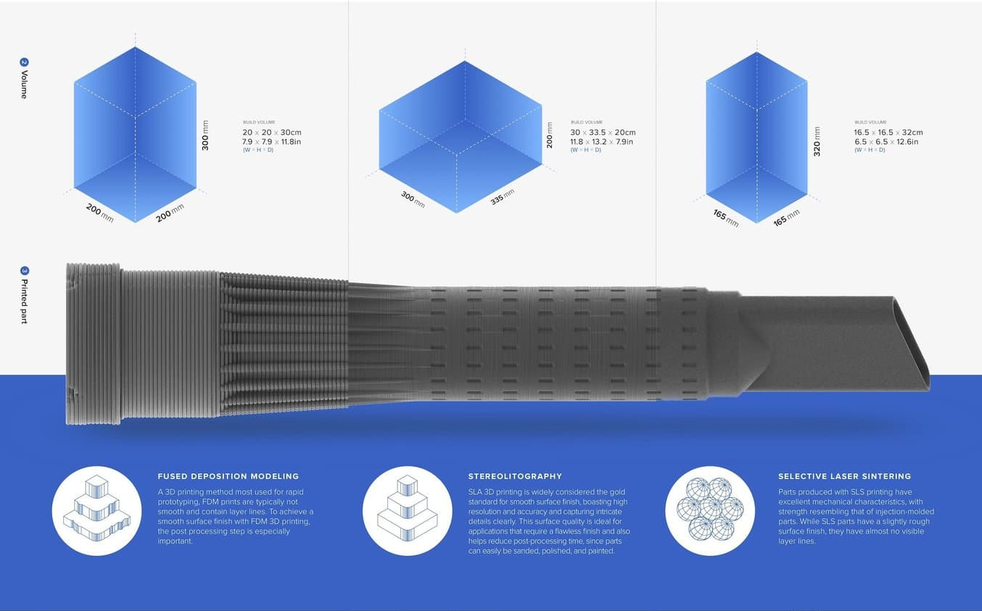
Comparision MEX vs VP and PBF

Slide 62
Mark the right sentence
Polymer Powder Bed Fusion prints require support
Vat Photopolymerization has a low resolution
MEX is suitable for parts with very small details.
One of PBF’s applications is orthopedics.

Slide 63
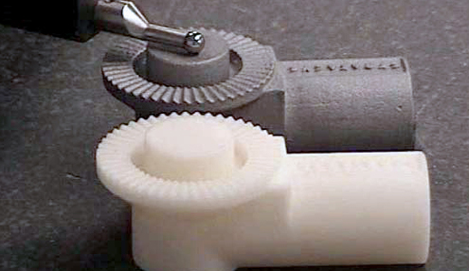
MEX applications
MEX serves as a quick, cost effective, prototyping and design verification tool. It is also suited for creating functional parts for mainly non-commercial use. Some of the most common applications of MEX printers are presented throughout this section.
Investment casting patterns
The low cost of MEX materials and the geometries the process is able to produce make it a good solution for investment casting patterns.
Because the infill structure printed inside MEX parts is not solid, it also allows for less material to be used, making burnout easier during the casting process.

Slide 64
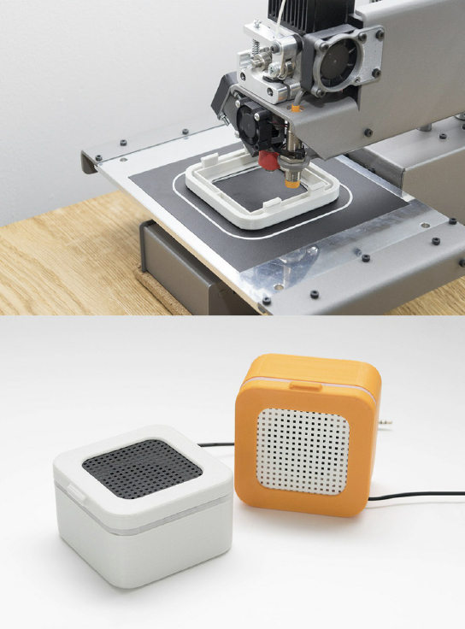
MEX applications
Electronics housings
Electronic housings or enclosures are one of the most popular applications for MEX printing. MEX allows a designer to create a prototype or final design in a matter of hours and is much cheaper compared to traditional manufacturing methods.
3D printed enclosures offer an effective method of confirming design geometry and several of the materials that can be used for printing enclosures are suitable for end use applications.

Slide 65
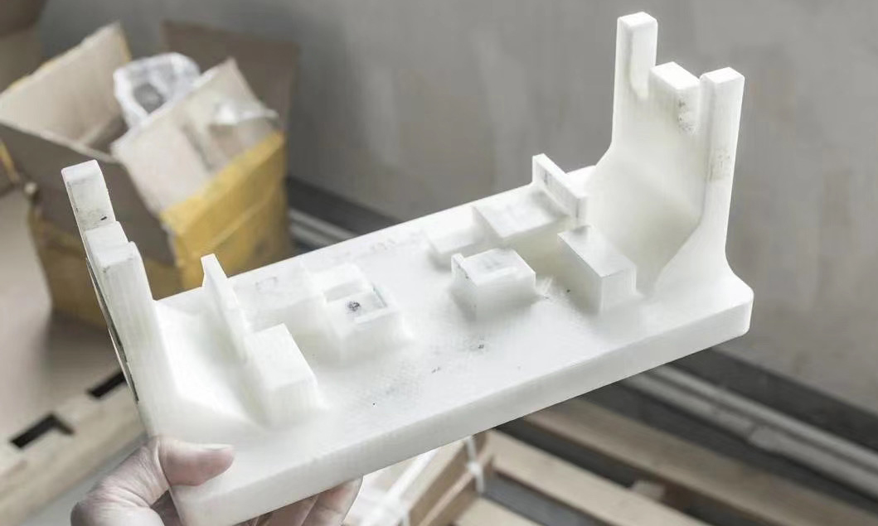
MEX applications
Form and fit testing
Form and fit designs are used to showcase the geometry as well as provide haptic feedback to the designer. MEX allows for the creation of curves and organic shapes which would be difficult to produce using traditional manufacturing techniques.
Jig and fixtures The high level of customization and complexity that MEX allows for in a design coupled with the speed and accuracy at which parts can be produced, make it suitable for creating grips, jigs and fixtures.

Slide 66
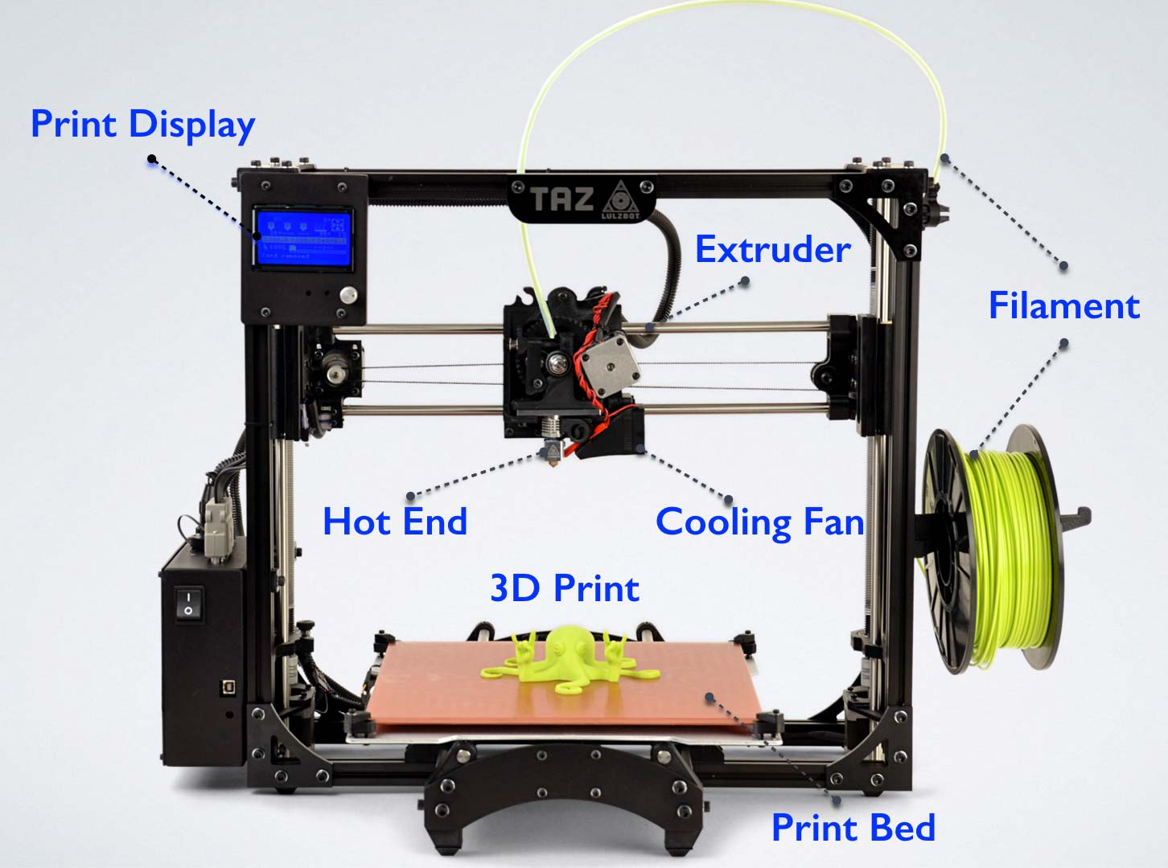
MEX equipment and terminology

Slide 67
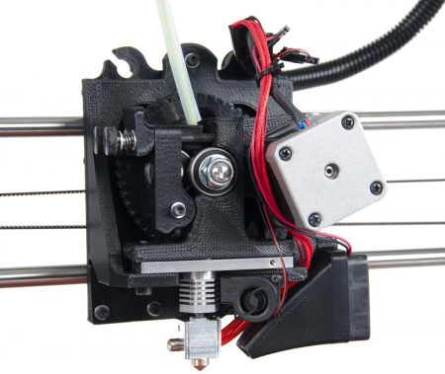
MEX equipment and terminology
Extruder
The extruder is one of the main significant components in the 3D printer. It is responsible for transmitting and sending the right amount of filament material to the hot end where the filament is melted and extruded down in thin layers to create an object. It is momentous to note that the extruder isn’t the same as the hot end. The extruder is generally referred to as the “cold end” because the filament material is “cold” when it transmits through the extruder to the hot end.

Slide 68
MEX equipment and terminology
Extruder
There are two basic types of extruder depending to the drive– Direct extruder and Bowden extruder
Direct Extruder: Direct extruders are simply extruders that are directly attached to the hot end. It’s important to note that a direct extruder is not necessarily the same thing as a direct drive extruder. A direct drive extruder just means that the filament drive mechanism is directly mounted to the motor shaft. Both bowden and direct extruders can be direct drive.

Slide 69
MEX equipment and terminology
Extruder
There are two basic types of extruder depending to the drive– Direct extruder and Bowden extruder
Bowden Extruder: A Bowden extruder is not directly attached to the hot end. Instead, a tube extends from the extruder body to the hot end. This is called a Bowden tube. The filament is constrained by the tube and travels through it to the hot end.

Slide 70
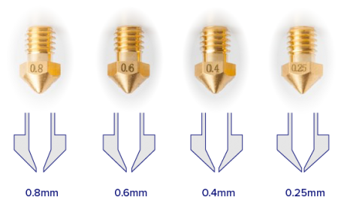
MEX equipment and terminology
Nozzle
The peak of Hot End is called Nozzle. Filament material turns out in the nozzle. According to requirement nozzle should be exchangeable. Size of the nozzle is really important. It generally varies within 0.25 mm to 0.80 mm. 0.5 mm nozzle is the most widely used. But according to desired output and required design, the best practice is that change sizes of the nozzle.

Slide 71
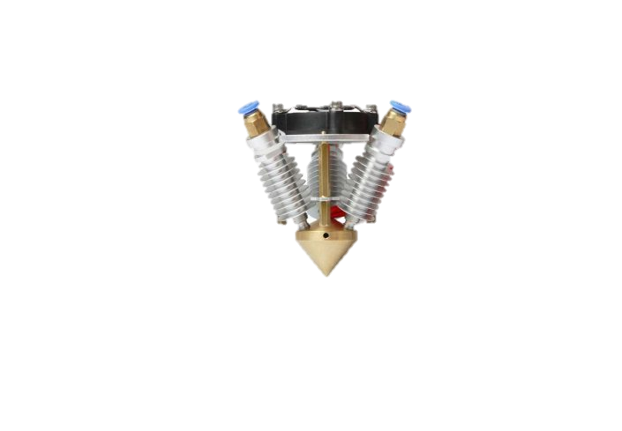
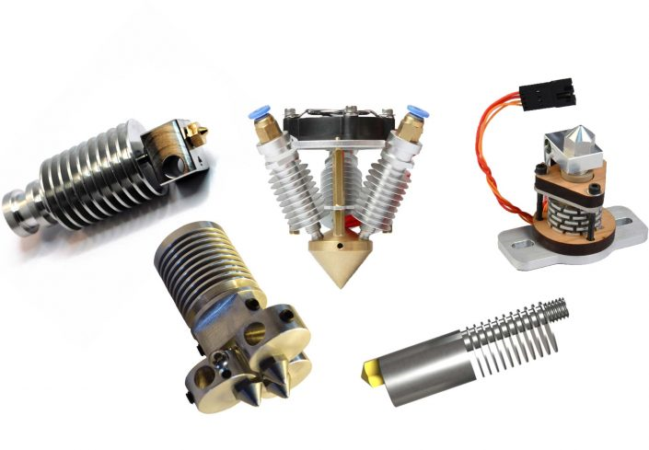
MEX equipment and terminology
Hot End
The Hot End is one of the main part in the extruder of a 3D printer. Hot End is the part where the plastic is melted and after that extruded in small tiny layers. Nowadays in the market there are a wide range of types of Hot Ends available.

Slide 72
MEX equipment and terminology
Heated Bed
A heated bed needed for high-level temperature extrusion filament materials. Heated bed will keep heated up to the plastic during a printing procedure as well as detain it from distorting. Also, heated bed will guarantee the best adhesion among the layers of output material, which is the outcome in the best structural integrity of printed objects. Heated bed was pivotal to the first layer to ensuring the best level of foundation. Generally temperature range is 40 °C to 110 °C.
Cooling Fan
A major role in the 3D printing process is played by Cooling Fan. A cooling process is not required in every one of the 3D printing materials, but it is really advantageous for most 3D printers. Some 3D printers have only one cooling fan, where other 3D printers have up-to three cooling fans. A Cooling Fan will be accurately modified overhanging characteristics, will brittle but rigid the sharp edges and will result in better bridging capabilities.

Slide 73
MEX equipment and terminology
LCD Display
The LCD Display controller enables to 3D printing without any requirement of a computer connection or by using the software host, for example, Cura. It required an SD card for reading the G-code commands. The display permits more effective space usage and frees up to the computer for other works. It is perfect for everyday printing and will be utilized in the majority of print objects.
Stepper Motor
For 3D printer, stepper motor is another essential component. Stepper motor is a DC motor that has multiple coils allowing them to move in small increments. These multiple coils are connected in the groups which are called phases. By energizing every phase in order, a motor will be rotated, in only 1 step at a time. By using a computer that movements will be control, it can be very precise. Stepper motor is the best utilized for low-speed torque, speed control, and positioning.

Slide 74
MEX equipment and terminology
Stepper Motor
According to the variety of 3D printer, stepper motor is utilized for different applications e.g., a stepper motor is utilized for moving the extruder or build the stage in x, y, and z-direction. Even the extruder have a stepper motor for pulling the filament material. It is regularly utilized for printers and robotics.

Slide 75
MEX equipment and terminology
Controller Board
Controller board are the brains of the 3D printer, powering everything from motors to Hot End. The processing power of the controller board can play a large role in how detailed prints of a 3D model which come out as a final product.
The Control board is made up of two components: a microcontroller and a circuit board. These components can be either combined into one board or be separate units attached to each other. Both work simultaneously to control and distribute power to all other components.

Slide 76
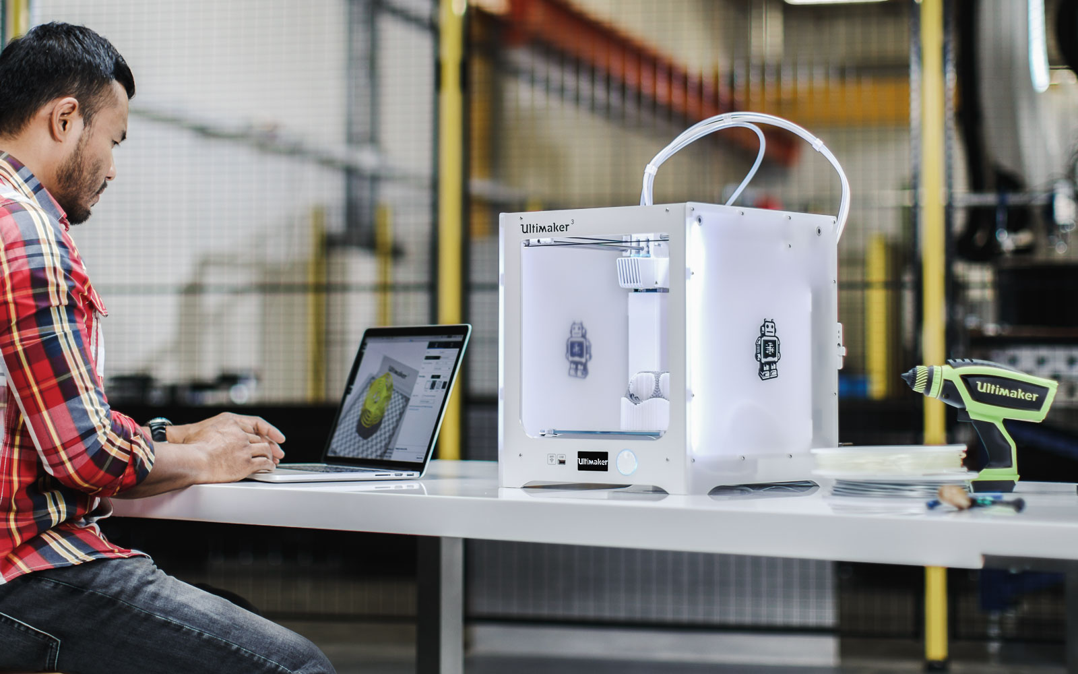
MEX equipment types
Desktop 3D printer
Desktop 3D or consumer MEX printing targets hobbyist and amateur home users with small, affordable and easy-to-use 3D printers. It lets the consumers or hobbyists experiment with their CAD designs and get an idea about their feasibility.
Since MEX filaments are also cheaper in price, it gives a large scope for the correction of the initial design and for any modifications.

Slide 77
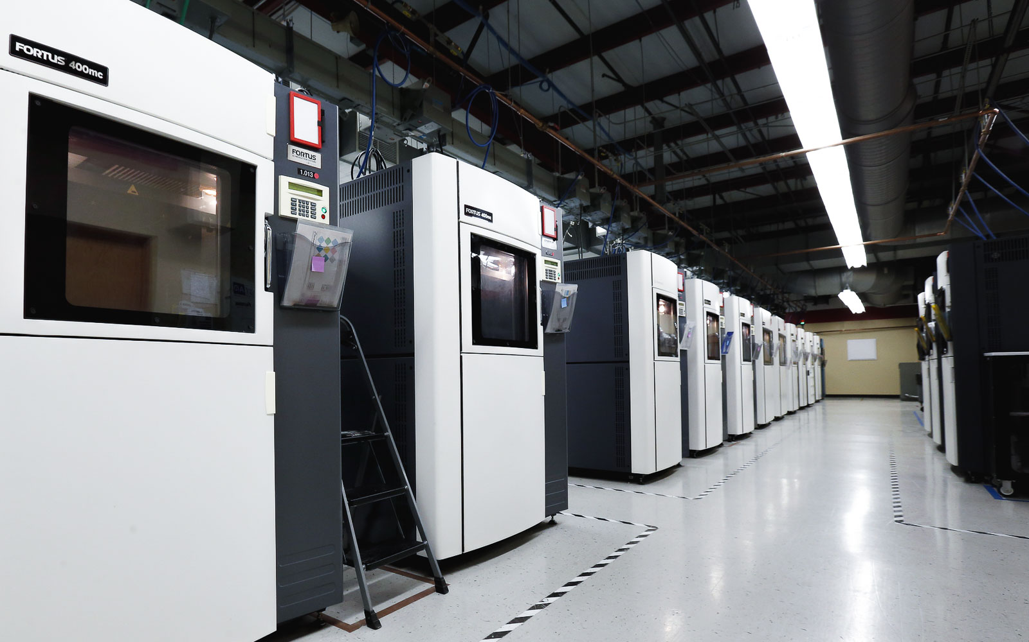
MEX equipment types
Industrial 3D Printer
Industrial 3D printing (also called professional 3D printing) is the industrial-grade counterpart to consumer 3D printing. It is mainly used for concept modeling, tooling, manufacturing, functional prototypes as well as end-use parts.
Professional printers, like Stratasys 3D printers, are significantly more expensive, powerful and efficient than desktop printers.

Slide 78
Desktop vs Industrial 3D Printer
 | Desktop | Industrial
Price | MEX is one of the cheapest printing options available in the market. Its price may start with already 200 € | Professional 3D printers are used by designers and product manufacturers for making moulds and prototypes. They must also be capable of printing large objects efficiently and hence are expensive.
Build volume | Consumer 3D printers are designed for home use. The size of print varies from 10 x 10 x 10 mm to 200 x 200 x 200 mm. | Build volume determines the largest part that can be built at once. The build size varies from 200 x 200 x 300 mm to 914 x 610 x 914 mm depending on the printer.
Materials | The most common materials for hobbyist 3D printing are PLA, ABS and PETG | The most common materials are PC and ABS.

Slide 79
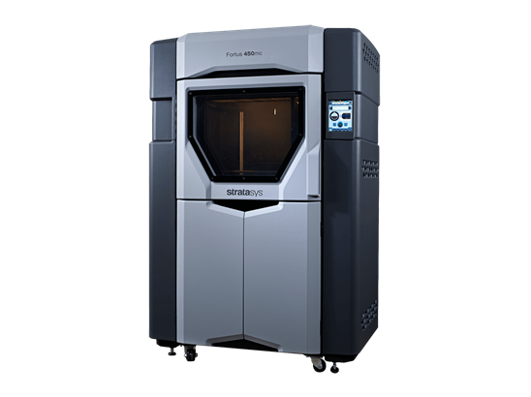
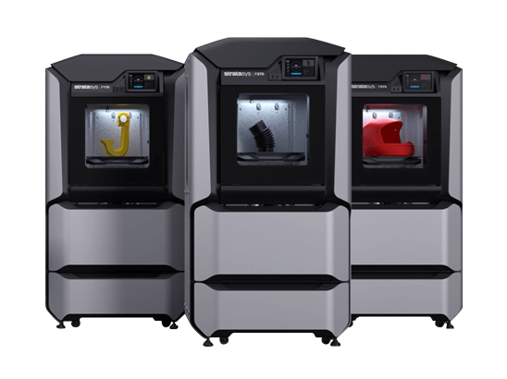
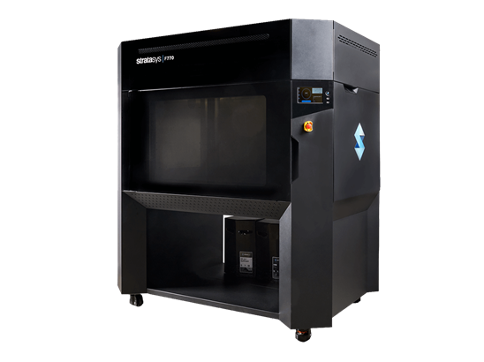
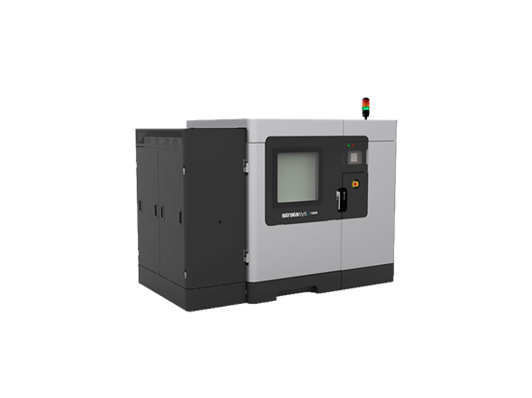
Industrial 3D Printer. Examples
Stratasys MEX printers
FORTUS 450MC
F770
F123 Series
F900

Slide 80
Mark which is not a part of the MEX 3D Printer
Hot End
Nozzle
Point Laser
Cooling Fan

Slide 81
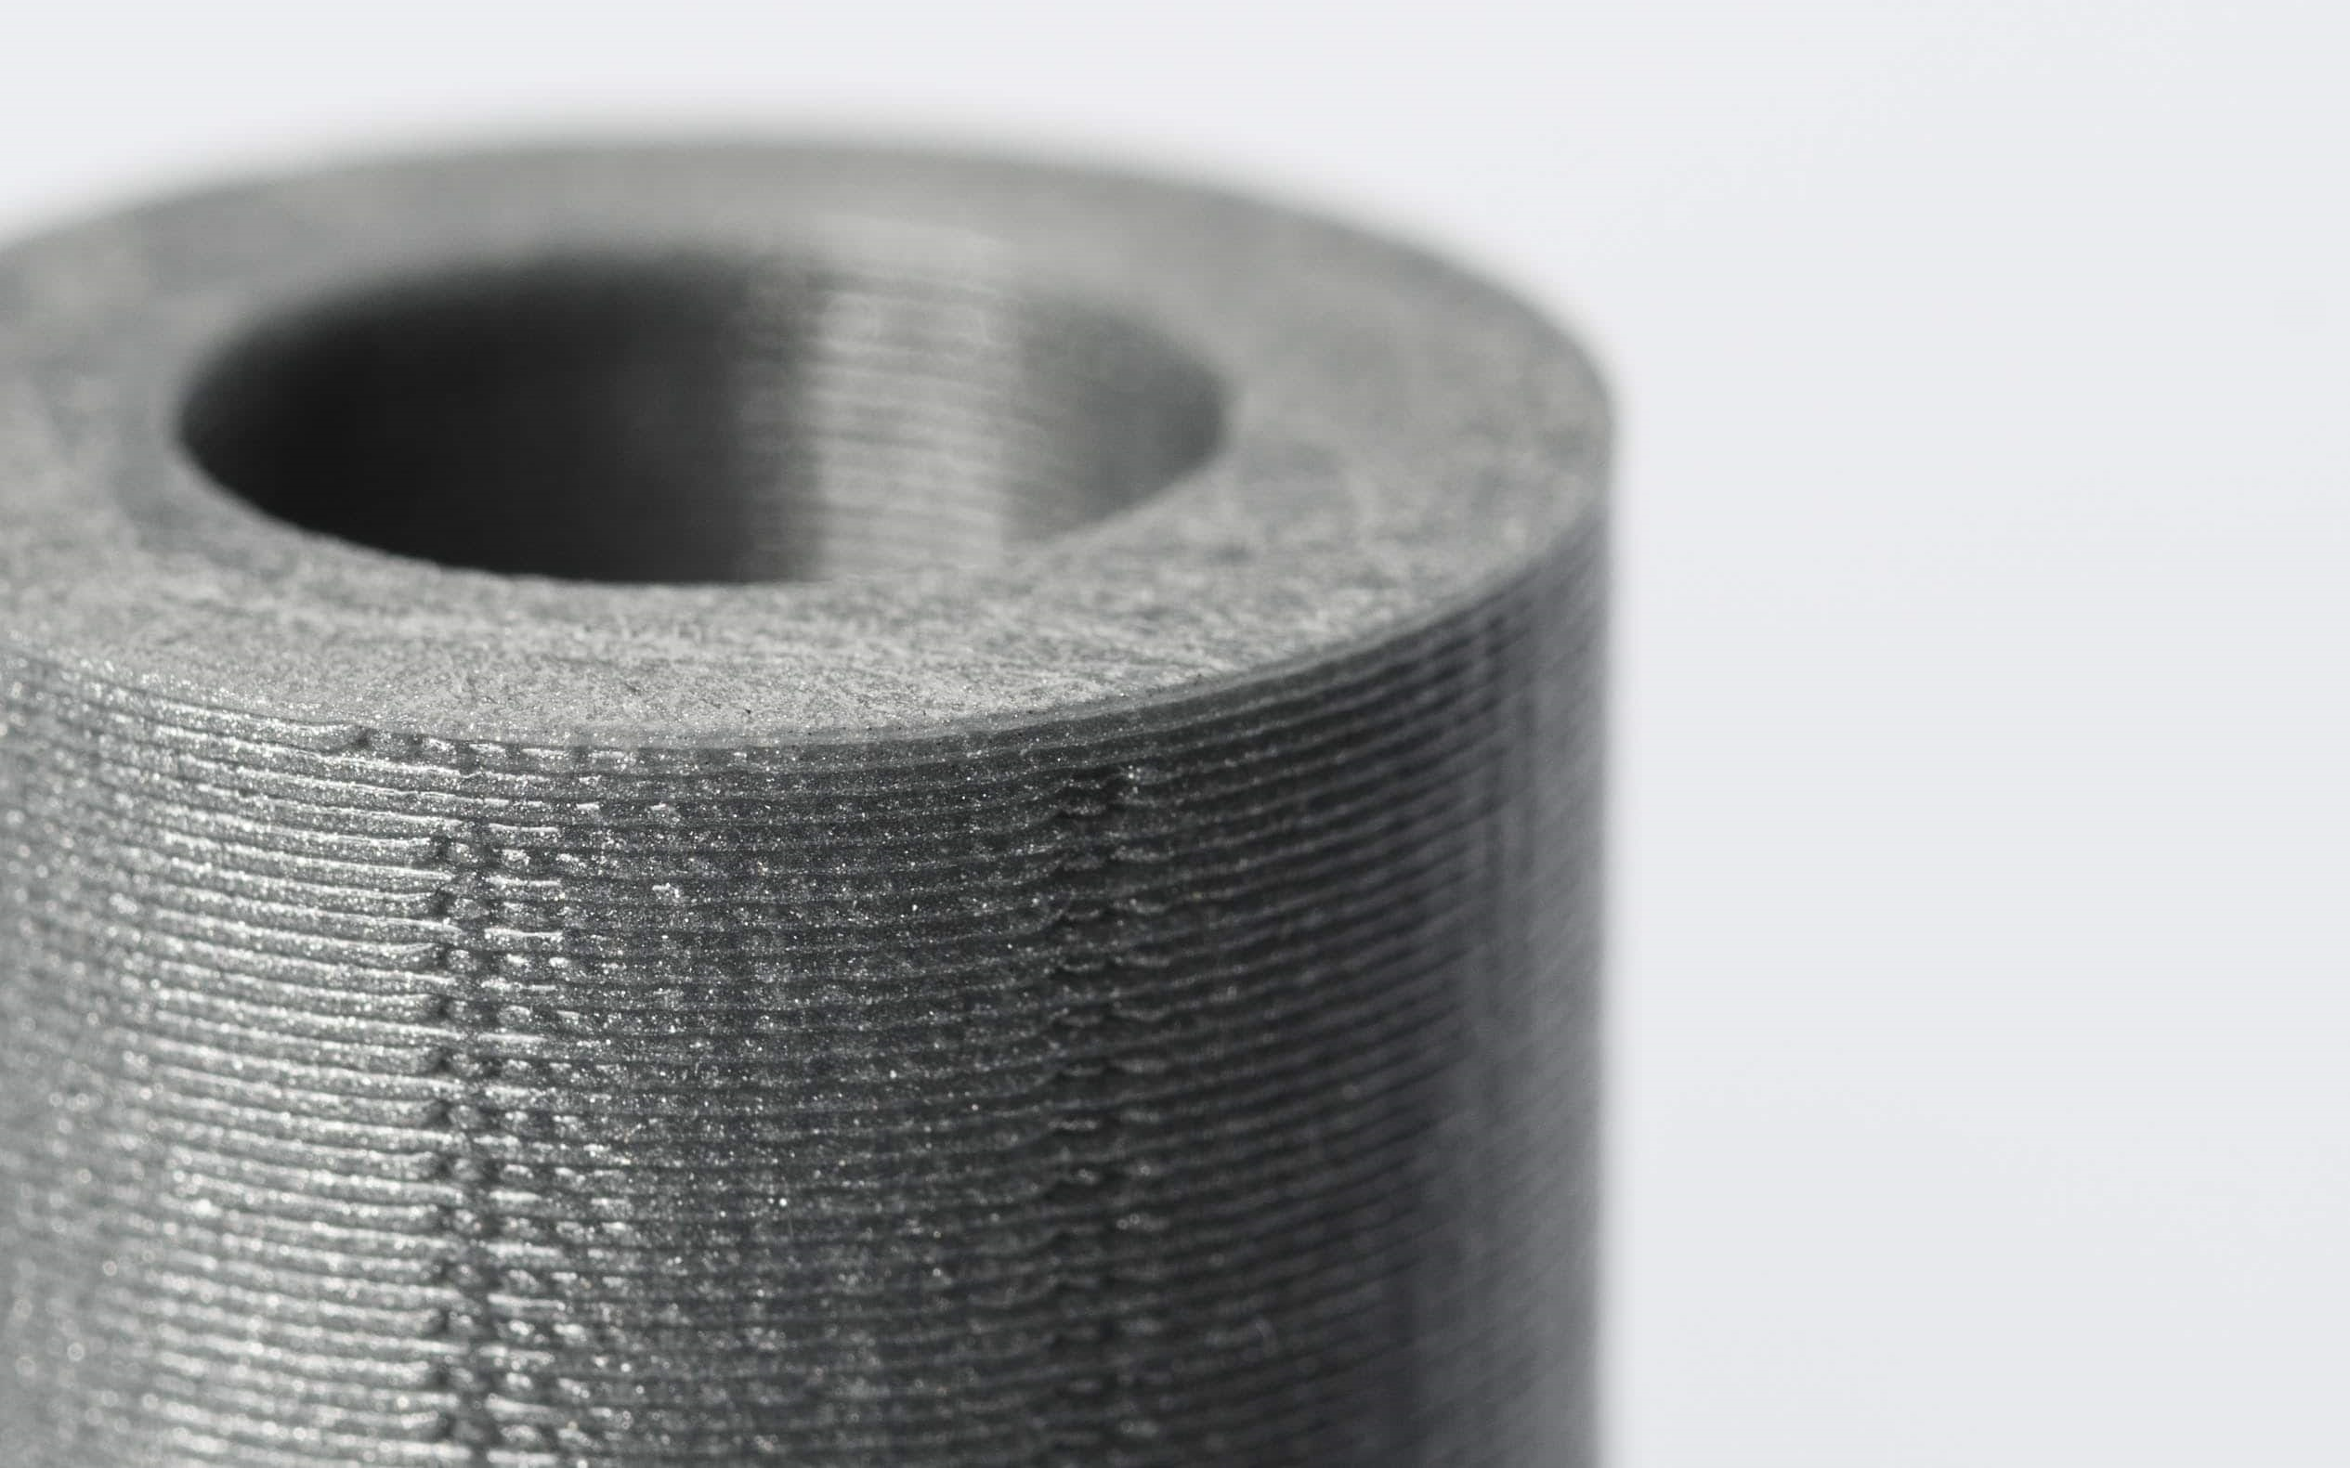
Properties of MEX parts
MEX has the lowest resolution compared to other 3D printing technologies, so it is not suitable for parts with very small details.
Infill percentage also has an effect the strength of a part. Most printers produce parts with 20% infill. Higher levels of infill will resulting a stronger part, but will increase build time and cost.
The layer-by-layer method of printing also means that MEX parts are likely to have visible layer lines and often require some form of postprocessing if a smooth surface finish is desirable.

Slide 82

Process chain operations. Post-processing
Some process chain operations as post-processing are actually umbrella terms for a number of stages that 3D Printing parts may need to go through after they come out of the 3D Printing system and before they are fit for purpose. The term “post-processing” is often used interchangeably with “finishing”, which is somewhat confusing. Thus “finishing” is actually a subset of post-processing, not a term that should be used interchangeably with post-processing.
Post-processing will be explained in details in other unit.

Slide 83
02
Overview on Polymer Materials, their properties and applications

Slide 84

MEX processable materials
The most of materials using in MEX are polymers. The figure summarizes the current availability of the most important polymer types as filaments for MEX.
Apart from PLA and ABS, particularly poly(ethylene terephthalate) and PC can nowadays be already declared as standard MEX-AM materials

Slide 85

MEX processable materials
In contrast to photopolymerization, and powder-based AM techniques, MEX allows to use a wide range of thermoplastics that are commercially available in spools, satisfy nearly all the material requirements discussed above, and are moderately priced compared with other 3D Printing techniques.

Slide 86

MEX processable materials
Until the year 2012, the materials for MEX , especially those for low cost 3D printers, were mainly limited to poly(lactic acid) (PLA) and acrylonitrile butadiene styrene (ABS), due to their facile processability both in terms of filament extrusion and MEX.
Up to now, these two materials are still the top sellers among the MEX material portfolio and are two of the few materials that can be processed nearly without distortions.

Slide 87

Polymers. MEX processable materials
Acrylonitrile butadiene styrene-ABS
ABS filament is the most commonly used 3D printing plastics. It is used in the bodywork of cars, appliances, and mobile phone cases. It is a thermoplastic which contains a base of elastomers based on polybutadiene, making it more flexible, and resistant to shocks. ABS can also be found in powder form for powder bed processes such as SLS, and liquid form for SLA and PolyJet technologies. It is readily affordable, strong, and lightweight. ABS filament comes in a broad range of colors and can be used for anything from architectural and concept models to DIY projects and manufacturing.
Compared to many other fiber filaments ABS is quite cost-effective. Along with being durable against impact and fatigue, ABS is also heat resistant and water-resistant.

Slide 88

Polymers. MEX processable materials
Acrylonitrile butadiene styrene-ABS
ABS is used in 3D printing when heated between 230ºC and 260ºC. It is a tough material, able to easily withstand temperatures of -20ºC to 80ºC. In addition to its high strength, it is a reusable material and can be welded with chemical processes. However, ABS is not biodegradable and shrinks in contact with air, so the printing platform must be heated to prevent warping. Moreover, it is recommended to use a closed chamber 3D printer to limit particle emissions when printing with ABS.
ABS is the perfect 3D printing material to use for a moving part, high mechanical stress, or for high-stress functionality. ABS is also a good option for an end-use product, as it has an attractive surface finish.

Slide 89

Polymers. MEX processable materials
Acrylonitrile butadiene styrene-ABS
The downside of ABS is that it has to be extruded at a higher temperature: Its glass transition temperature is ~105 °C. ABS is amorphous and therefore has no true melting point, however 230°C is the standard for printing.
Not only does it have better strength and toughness than PLA, but it also has better resistance to corrosive chemicals, making ABS more attractive for use in MEX. However, it is slightly difficult to print due to the tendency to warp, attributed to a high shrinkage factor.

Slide 90

Polymers. MEX processable materials
Polylactic acid-PLA
Known as polylactic acid, or PLA, this material has the benefit of being biodegradable, unlike ABS. PLA is manufactured using renewable raw materials such as corn starch but sugar cane and tapioca varieties can also be found.
PLA is one of the easiest materials to print, though it does have a tendency to shrink slightly after 3D printing. It is not necessary a heated platform when printing in PLA, unlike with ABS. PLA also prints at a lower temperature than ABS, between 190ºC to 230ºC. PLA has a relatively low melt point around 145–186 ◦C and can be easily formed into filament with a temperature over 185–190 ◦C.

Slide 91
Polymers. MEX processable materials
Polylactic acid-PLA
PLA is a more difficult material to manipulate due to its high cooling and solidification speed. It is also important to mention that models can deteriorate when in contact with water. However, the material is consistent, simple to use, and comes in a wide variety of colors, making it suitable for MEX 3D printing. For this reason, many people prefer it over ABS. Moreover, it is a suitable 3D printing material for single-use food contact and it contracts less than ABS when cooling. Biocompatibility and good mechanical properties (relatively high strength and modulus) of PLA make it popular in the industrial packing and biomedical field. However, PLA is less durable than ABS and susceptible to heat.
The name "polylactic acid" does not comply with IUPAC standard nomenclature, and is potentially ambiguous or confusing, because PLA is not a polyacid (polyelectrolyte), but rather a polyester. PLA has a crystallinity of around 37%, a glass transition temperature 60–65 °C, a melting temperature 173–178 °C and a tensile modulus 2.7–16 Gpa.

Slide 92
Polymers. MEX processable materials
Polyethylene terephthalate-PET
Polyethylene terephthalate, or PET, is a semi-crystalline polymer and one of the polyester family and is commonly seen in disposable plastic bottles. PET is the ideal filament for any pieces intended for contact with food. Moreover, the material is fairly rigid and has good chemical resistance. To obtain the best results when printing with PET, print between 75 – 90ºC. PET is commonly marketed as a translucent filament, with variants such as PETG, PETE, and PETT also sold. Advantages of PET include that the material doesn’t release any odours when printing, and is 100% recyclable.
This material is the second alternative to ABS. Unlike ABS, PET does not emit odorous fumes when melted, but it is just as strong and flexible.
More importantly, PET does not require a heated bed. This material has a glossy finish, is flexible, and is food safe, which makes it a popular choice for many consumer products. PET 3D printing materials must store in vacuum bags or containers to protect against humidity.

Slide 93

Polymers. MEX processable materials
Polyethylene terephthalate-PET
It's strength is much higher than PLA, it is FDA approved for food containers and tools used for food consumption, it barely warps, and produces no odors or fumes when printed. PET filament is not biodegradable, but it is 100% reclaimable. PET 3D printer filament is known for its clarity and is also very good at bridging.

Slide 94
Polymers. MEX processable materials
Glycolized polyester-PETG
PETG, or glycolized polyester, is a thermoplastic widely used in the additive manufacturing market, combining both the simplicity of PLA 3D printing and the strength of ABS. It is a variant of polyethylene terephthalate-PET that has been combined with glycol to achieve a number of desirable effects for 3D printing such as high transparency. It is an amorphous plastic, which can be 100% recycled. It has the same chemical composition as PET. Glycol has been added to reduce its brittleness and therefore its fragility. PETG has better printability compared to ABS and enables the production of 3D products with smooth surface finish and excellent impact resistance, but PETG has the high absorbability of moisture from the air.
Moreover, PETG 3D printing materials can be printed at lower temperatures while increasing its flow speed (up to 100 mm/s) which in turn translates into speedier prints. PETG components are weather-resistant and are thus often used for garden appliances.

Slide 95

Polymers. MEX processable materials
Glycolized polyester-PETG
Another selling point is its use as a food-safe 3D printing material. When using for home 3D printing, store this material in vacuum bags or containers to protect against humidity.
3D printing beginners should turn to PET-G (Polyethylene terephthalate glycol-modified) when looking for a 3D printing material that is both strong and easy to print.
PET-G is easier to print than ABS, yet stronger and more technical than PLA. PET-G is impact-resistant, abrasion-resistant, and also features some flexibility.
Featuring a shiny finish and good levels of strength, PET-G is a great option for end-use parts. It is commonly used to print functional prototypes, mild-stress parts, and protective cases.

Slide 96

Polymers. MEX processable materials
Polycarbonate-PC
PC is one of the engineering plastics and has carbonate groups in their chemical structure. PC is popular in 3D printing owing to its excellent mechanical properties (toughness, flexural strength, and impact resistance) and wide heat resistance ranging from 150 ◦C to 140 ◦C. Therefore, it is widely used for tough applications such as functional testing and tooling.
However, PC is one of hygroscopic plastics, meaning that it absorbs moisture in the air. To prevent the degradation of the filament, it should be stored in dry or airtight environment. It is also prone to occur warping between the filaments and the build plate or between filaments.

Slide 97

Polymers. MEX processable materials
Polycarbonate-PC
When the PC is printed without heated environment, residual stress can be created in the polymer, and as printing proceeds, the residual stress eventually overcome the bed or inter-layer adhesion, causing distortion. Therefore, it is important to ensure sufficient bed adhesion by controlling the bed and environmental temperature (Bed temperature: 90–105 ◦C, environmental temperature: ~250 ◦C) and adjusting the gap between nozzle and the bed.

Slide 98
Polymers. MEX processable materials
Thermoplastic polyurethane-TPU
TPU, or thermoplastic polyurethane, is another common flexible material and is easily confused with TPE.
A simple explanation is that TPU is a type of TPE. That’s because TPE isn’t really one specific material; it refers to a range of elastic thermoplastics, of which TPU is one.
Recently, “TPU”, both as a term and as a material, has been gaining popularity over “TPE”. In today’s 3D printing scene, most flexible offerings are TPU-based materials, with TPE having fallen largely out of favor due to difficulties faced while printing.
To avoid any confusion, it is better will differentiate the materials based on technical hardness ratings. Flexibles rated at 90A hardness or below will be considered TPE, even if the material is TPU-based.

Slide 99

Polymers. MEX processable materials
Thermoplastic polyurethane-TPU
With the ability to extend up to 4.5 times its original size without breaking, TPU is a good choice for any prints that require high levels of flexibility and strength. TPU is commonly used to print parts like wheels, springs, shock absorbers, and other flexible objects.
The disadvantages of TPU filament are often strings and difficult to post process.

Slide 100
Polymers. MEX processable materials
Nylon/PA
Given its flexibility and strength, nylon is the premier choice for a wide range of applications in MEX It is a filament that has many interesting characteristics, including great flexibility, resistance to impact or abrasion. Additionally, its mechanical properties are quite close to ABS. However, nylon will require the presence of a heated plate inside the 3D printer (that can reach around 80°C) due to adhesion issues. It will also be necessary to take care of storage because it quickly absorbs the surrounding humidity (hygroscopic material) which could impact printing later. As such, PA should be stored in a dry place with silica gel. In practice it absorbs around 10% of its weight in water. When the material is heated during printing, the moisture bursts, affecting not only the bed and layer adhesion but also giving the surface a rough finish. In terms of extrusion temperature, the 3D printer will have to rise to 250°C, or even 220°C for certain types of PA.

Slide 101

Polymers. MEX processable materials
Nylon/PA
It is therefore recommended to dry nylon material before printing. Oven drying is the best precaution from ensuring a successful print.
Nylon filaments are a good alternative to polycarbonate because they are easier to print. They will have a better lifespan, therefore ideal for printing parts that need to be resistant. Among MEX filaments, the layer bonding of nylon is stronger than all others, making it the ideal 3D printing material for parts that require good tensile and mechanical strength. Therefore nylon is used to print tools, hinges or machine components that need good resistance.

Slide 102

Polymers. MEX processable materials
Polyether-ether-ketone-PEEK
PEEK is a semicrystalline polymer in the Polyaryletherketone (PAEK) family and one of the advanced plastics, which has a high melting temperature. PEEK was difficult to print due to the high melting temperature around 343 ◦C, but as the hot end in MEX printer has recently progressed, it has led to the development of PEEK filaments for more general MEX.
Moreover, many advantages of PEEK, including excellent mechanical and chemical resistance properties (high resistance to biodegradation and thermal degradation), allow the applications of the polymer in extreme conditions requiring high service temperatures or mechanical properties such as bone, bearing, piston parts, vehicle, and aircraft.

Slide 103
Polymers. MEX processable materials
The table compares them in terms of physical and mechanical properties, and printing conditions.
 | PLA | ABS | Nylon6 | PC | PETG | PEEK
Glass transition temperature (ºC) | 53-64 | 102-115 | 47-57 | 140-151 | 75-80 | 137-152
Melting temperature (ºC) | 145-186 | - | 220 | 220-260 | - | 335-343
Heat deflection temperature (ºC) | 56 | 100 | 190 | 190 | 71 | 160
Modulus (Gpa) | 1.2-3.0 | 1.8-2.39 | 2.8-3.1 | 2.34 | 0.9-1.1 | 3.56
Tensile strength (Mpa) | 28-50 | 25-65 | 79 | 62 | 55 | 92
Printing temperature (ºC) | 190-220 | 220-250 | 220-270 | 260-310 | 230-250 | 360-450
Bed temperature (ºC) | 45-60 | 95-110 | 70-90 | 80-120 | 75-90 | 120-150

Slide 104

Polymers. Characteristics and effects
To evaluate the characteristics and effects of polymers in MEX, each material is ranked along the following criteria on a 1 (low) to 5 (high) scale.
These are relative grades for the MEX process, they would look quite different if other manufacturing technologies were taken into account.

Slide 105
Polymers. Characteristics and effects
The choice of material really depends on what the user wants to print, so the most common MEX polymers are listed the key decision criteria needed to choose a material (other than cost and speed):
Ease of printing: How easy it is to print a material: bed adhesion, max printing speed, frequency of failed prints, flow accuracy, ease to feed into the printer etc.
Visual quality: How good the finished object looks. More info on how we test it here.
Max stress: Maximum stress the object can undergo before breaking when slowly pulling on it.
Elongation at break: Maximum length the object has been stretched before breaking.
Impact resistance: Energy needed to break an object with a sudden impact.
Layer adhesion (isotropy): How good the adhesion between layers of material is.
Heat resistance: Max temperature the object can sustain before softening and deforming.

Slide 106



Polymers. Characteristics and effects

Slide 107



Polymers. Characteristics and effects

Slide 108
The easier to print MEX material is…
ABS
PLA
PC
TPU

Slide 109

MEX processable materials
Due to the wide selection of feedstocks, it is important to know material properties (physical and mechanical properties) and printability when choosing the right polymer for the finished product.
Visual quality refers to how good the printed part looks, which is determined by the surface quality such as smoothness of the surface. These points of view will be helpful to choose materials for MEX. Nowadays, as the demand for multifunctional materials increases, research has been conducted to make polymer composite filaments by mixing carbon nanomaterials, biomaterials, metals, and ceramics into the polymers.

Slide 110

MEX processable materials
Polymer composites
MEX processes allow for discrete, heterogeneous layering of a material for a laminate composite. The feedstock may alternatively be formulated prior to deposition for a matrix composite. Additives to polymer feedstock must be of the proper composition to yield an extrudate that is of low enough viscosity to deposit and provide strength over the entire part build time.

Slide 111
MEX processable materials
Composite filaments using carbon nanomaterials
As the demand for custom-shaped functional products increases, 3D printing for composites Carbon nanomaterials such as graphene/graphite and carbon nanotube (CNT) are actively utilized as reinforcement materials due to high electrical and thermal stability, low density, and good mechanical properties (strength, stiffness, and toughness).

Slide 112

MEX processable materials
Composite filaments using carbon nanomaterials
The carbon composites with high electronic conductivity are attractive in many potential applications especially in the field of electronics including energy storage devices, sensors, and electrically conductive structures.

Slide 113

MEX processable materials
Composite filaments using metals
Metal/polymer filaments are also actively used in energy storage devices, semiconductors, and circuits. The filaments come in diverse materials ranging from copper and bronze to iron and stainless steel.
Compared to metal printing, the metal-reinforced composites are easy to print because they do not need high-temperature extruder and cost-effective due to no requirement of a specific power distribution.
Among many types of metals, copper, aluminum, and stainless steel in powder form are actively used as reinforcement for filaments.

Slide 114

MEX processable materials
Composite filaments using biomaterials
Instead using petroleum-derived plastic such as nylon and PET, biobased materials, come from carbon-neutral feedstock like lignin, can help to reduce environmental pollution.
The eco-friendly filament can be fabricated by adding lignin into PLA. In particular, lignin is abundant in the fibrous parts of various plants.

Slide 115

MEX processable materials
Composite filaments using biomaterials
Compared to petroleum-based polymers, PLA, which has a lower carbon footprint in production, can be mixed with lignin to make composite filaments more environmentally friendly without mechanical degradation.
With the addition of lignin, PLA filaments became environmentally friendly without compromising the modulus of elasticity.

Slide 116

MEX processable materials
Composite filaments using ceramics
The high mechanical strength and hardness, good thermal and chemical stability, and feasible optical and electrical performance of ceramics make ceramics versatile materials.
Ceramic components are generally produced using conventional technologies, such as injection molding, die pressing, and gel casting, but takes long time to process and limits design flexibility. Ceramics are widely used as fillers for MEX printing to apply various applications including biomedical fields and electronics.

Slide 117

MEX processable materials
Composite filaments using fibers
Fiber-reinforced polymer composites have great potential in structural industries, including aerospace, automotive, and energy applications, due to high mechanical properties with lightweight.
Both discontinuous fibers (e.g., chopped glass fibers, chopped carbon fibers, and short basalt fibers) and continuous fibers (e.g., glass, carbon, and aramid fibers), are used as reinforcements for the composite, but continuous fiber-reinforced composites exhibit high performance compared to the discontinuous fiber-reinforced ones. Because continuous fibers have long aspect ratio and normally have aligned orientation in composites.

Slide 118
Materials selection
There are a couple of considerations that need to be taken into account when looking for the best material that fits your need. These considerations include application, function, geometry, and post-processing.
Application. When choosing a material for a certain project, it is important to ensure that the material can deliver the required certifications for the project. For example, some projects require materials that offer sterilization capabilities, biocompatibility, FDA certifications, fire-retardant certifications, chemical resistance, or other certifications that may be critical.
Function. MEX materials are subjected to extreme testing in order to answer the kinds of stresses it can endure and the level of taxing environment the material will excel in. The ability of a material to function in a desired application partly on design.
Geometry. It is important to consider the dimensional tolerances, design wall thicknesses, and minimum feature execution when choosing a material for MEX.
Post-processing. Some 3DP materials may be better suited to certain post-processing methods than others.

Slide 119
Join the MEX material with their application *
PLA- biobased food packaging
ABS- LEGO bricks
Nylon/PA-Machine components
PETG- Transparent parts
* Change answer by pictures

Slide 120

Summary
3D Printing is the process of building objects by creating successive layers of a material
A total of seven process categories were established.
Material Extrusion (MEX) is a AM process in which material is selectively dispensed through a nozzle or orifice
Among MEX examples is possible to find applications to COVID-19, art or medicine.

Slide 121
Summary
The most common feedstocks in MEX are polymers, metal infused polymers and composites
The most common polymers in MEX are ABS, PLA, PET, PC, TPU and Nylon
Nowadays, there are polymer composite filaments by mixing carbon nanomaterials, biomaterials, metals, and ceramics into the polymers.

Slide 122
Congratulations! ​
​
You have completed the unit. ​

