Slide 1
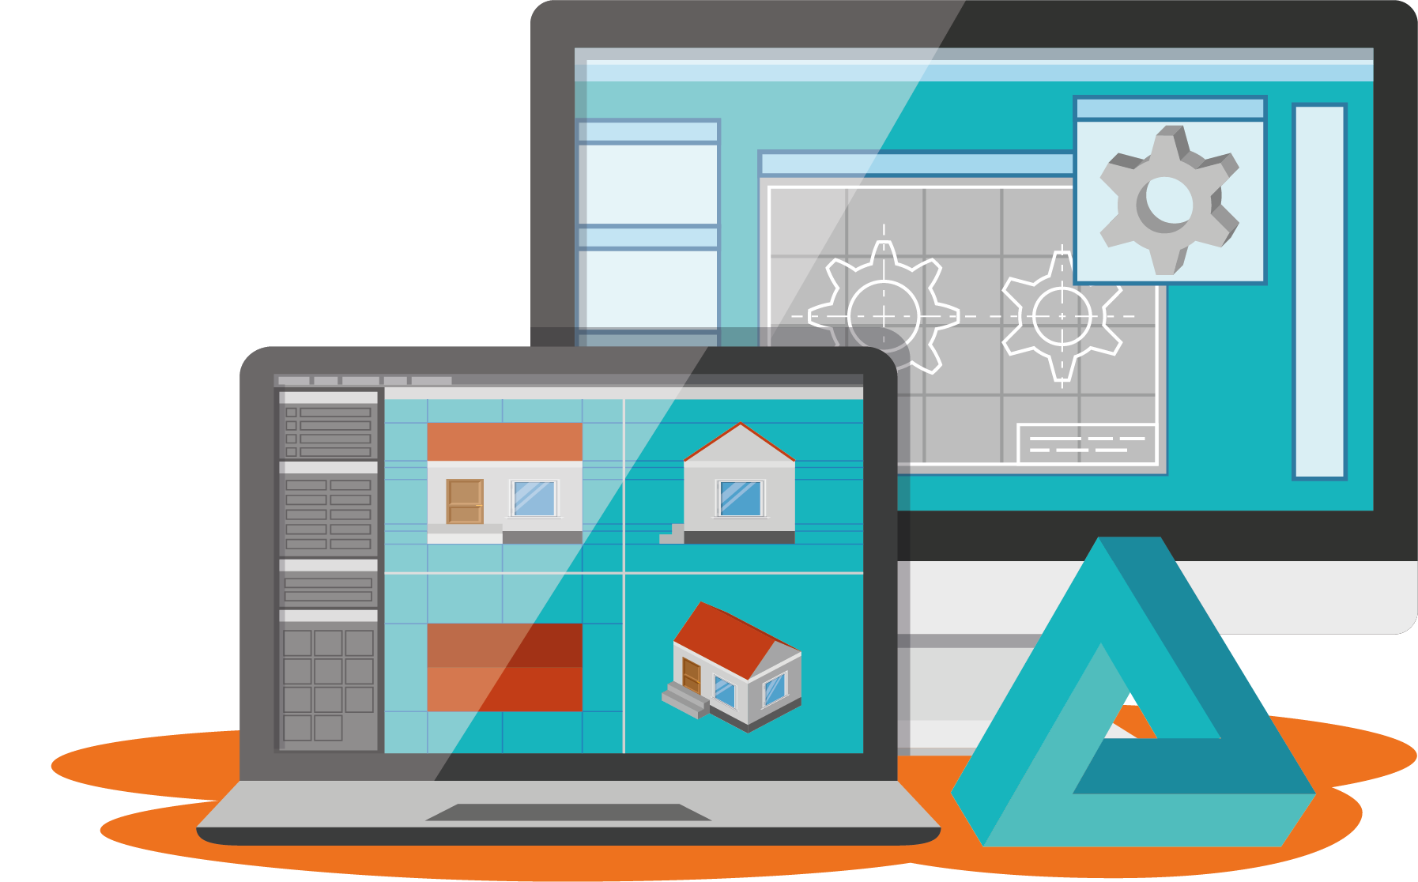
Material Extrusion
Learning Unit 2: Introduction to CAD

Slide 2
Content
01
02
03
04
Fundamentals of CAD
Introduction to Tinkercad
Overview of CAD
Types of CAD Modelling
3D CAD Software
Learning TinkerCAD
Solid Modelling
Preparing for 3D Print
3D modelling with TinkerCAD
Online Repositories
File Format for 3D Printing
Exporting a 3D design from TinkerCAD

Slide 3
Learning Outcomes
In this unit, the student will learn to:
Navigate the interface of a standard CAD software to view in the 3D space the models/or existing ones.
Manipulate objects in a 3D space by zooming in, zooming out and rotating the view.
Design simple solid shapes and combine them to form an assembly.
Create assemblies of 3D objects to make a final 3D model.
Save and export files ready for 3D Printing.

Slide 4

Introduction
This course will start by introducing the fundamentals of Computer-Aided Design (CAD), followed by a detailed exploration of the design workspace and tools of 3D modelling software to create custom 3D models. Last but not least, this course will cover the method to export the correct CAD files to a slicing program for 3D Printing.

Slide 5
01
Fundamentals of
CAD

Slide 6
Content
01
02
Overview of CAD
Types of CAD Modelling
Definition
2D CAD versus 3D CAD
History of CAD
Applications
The use of CAD in Product design and development
The advantages and disadvantages of CAD
Solid modelling
Surface modelling
Wireframe modelling

Slide 7

What is CAD?
What does CAD stand for?
(Fill in the blank)
Answer: Computer-Aided Design
Notes:
Formative assessment format: Fill in the Blank

Slide 8
C A D stands for
Computer-Aided Design
Definition:
The use of specialised computer software to digitally create two-dimensional (2D) drawings and (3D) three-dimensional models of real-world products.
Notes:
Have you ever used a computer to design 2D or 3D shapes? That’s CAD!
CAD stands for Computer-aided design.
It is defined as the use of specialised computer software to digitally create two-dimensional (2D) drawings and (3D) three-dimensional models of real-world products.
Image source:
https://www.indiaeducation.net/careercenter/computers-it/computeraideddesign/

Slide 9
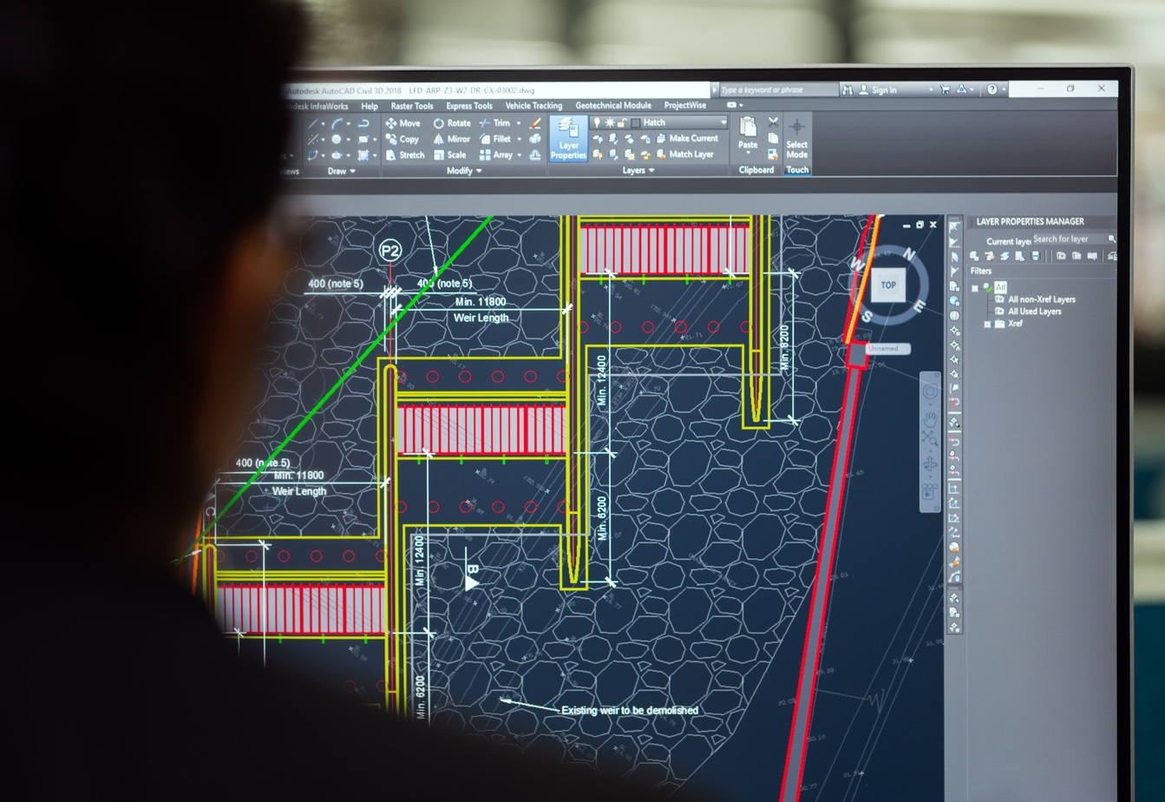
Two-Dimensional CAD (2D CAD)
2D CAD is the pioneer of CAD software, and was developed in the early 70s.
2D CAD relies on basic geometric shapes like lines, rectangles and circles to produce flat drawings.
It is often used for drawing, sketching and drafting conceptual designs.
It is a great starting point for most 3D designs.
Notes:
2D CAD is the pioneer of CAD software, and was developed in the early 70s.
Image source:
Unsplash (Free) - https://unsplash.com/photos/hoivM01c-vg

Slide 10
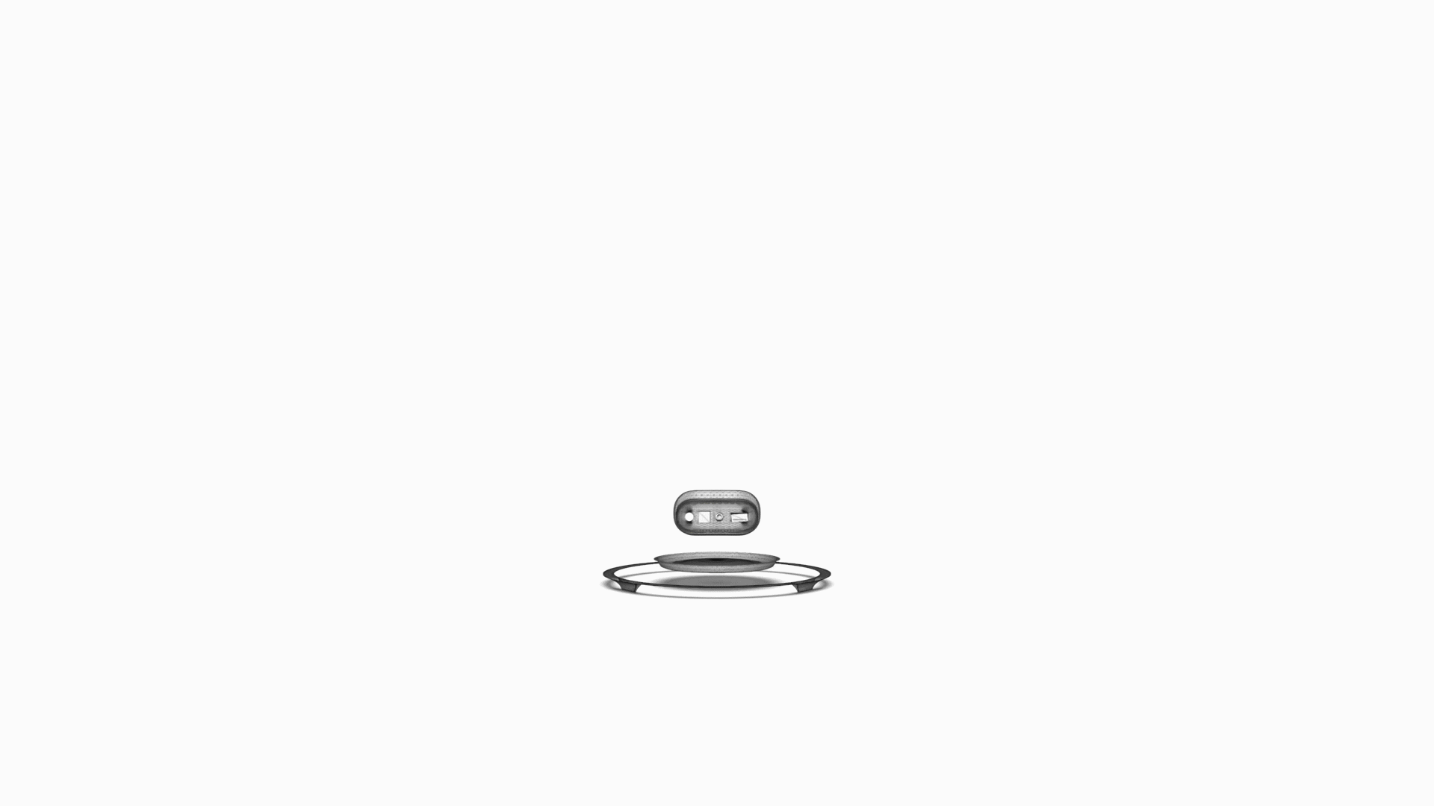
Three-Dimensional CAD (3D CAD)
3D CAD is used to digitally represent an object in three dimensions.
3D models can be rotated in any direction – X, Y or Z and viewed from any angle.
A CAD model will contain data like material properties, dimensions, tolerance and manufacturing process specific information.
Notes:
3D CAD is used to digitally represent an object in three dimensions, allowing more accurate scaling and visualization.
These programs allow designers to create coherent dimensions and designs by means of a visual interface.
The program takes care of all the calculations and creates the file with all coordinates, so the designer only has to worry about shapes and sizes.
It can simulate any fictional object or real-life object to understand how a design will perform before they are made.
We will go into the different types of 3D modelling later in this session.
Image source:
https://www.xo3d.co.uk/product-rendering/

Slide 11
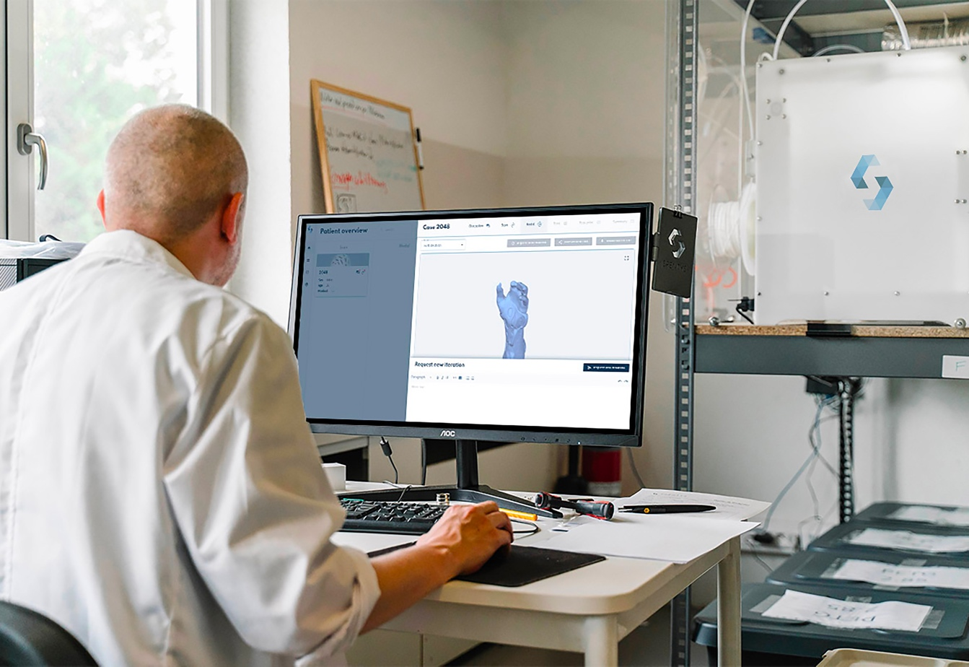
CAD modelling is an important part of a design process.
It enables the development, modification and optimisation of the design process, all within the virtual space of a computer before expanding to any physical resources.
CAD output is often in the form of electronic files for print, machining or other manufacturing operations.
Notes:
Today, CAD modelling is an important part of a design process.
CAD brings ideas to life in digital world before expanding any physical resources.
It enables user to layout and to develop their work on a computer screen, print and save it for future editing.
Image source:
Unsplash (Free) -https://unsplash.com/photos/DkAEPVsK2_8

Slide 12

A Walk Through The History of CAD
This short animated video takes you through a brief history of CAD from blueprints to the design horizon, and the evolution of CAD systems from costly workstations to off-the-shelf PCs.
Notes:
https://www.youtube.com/watch?v=mcwIMsh_g3o

Slide 13
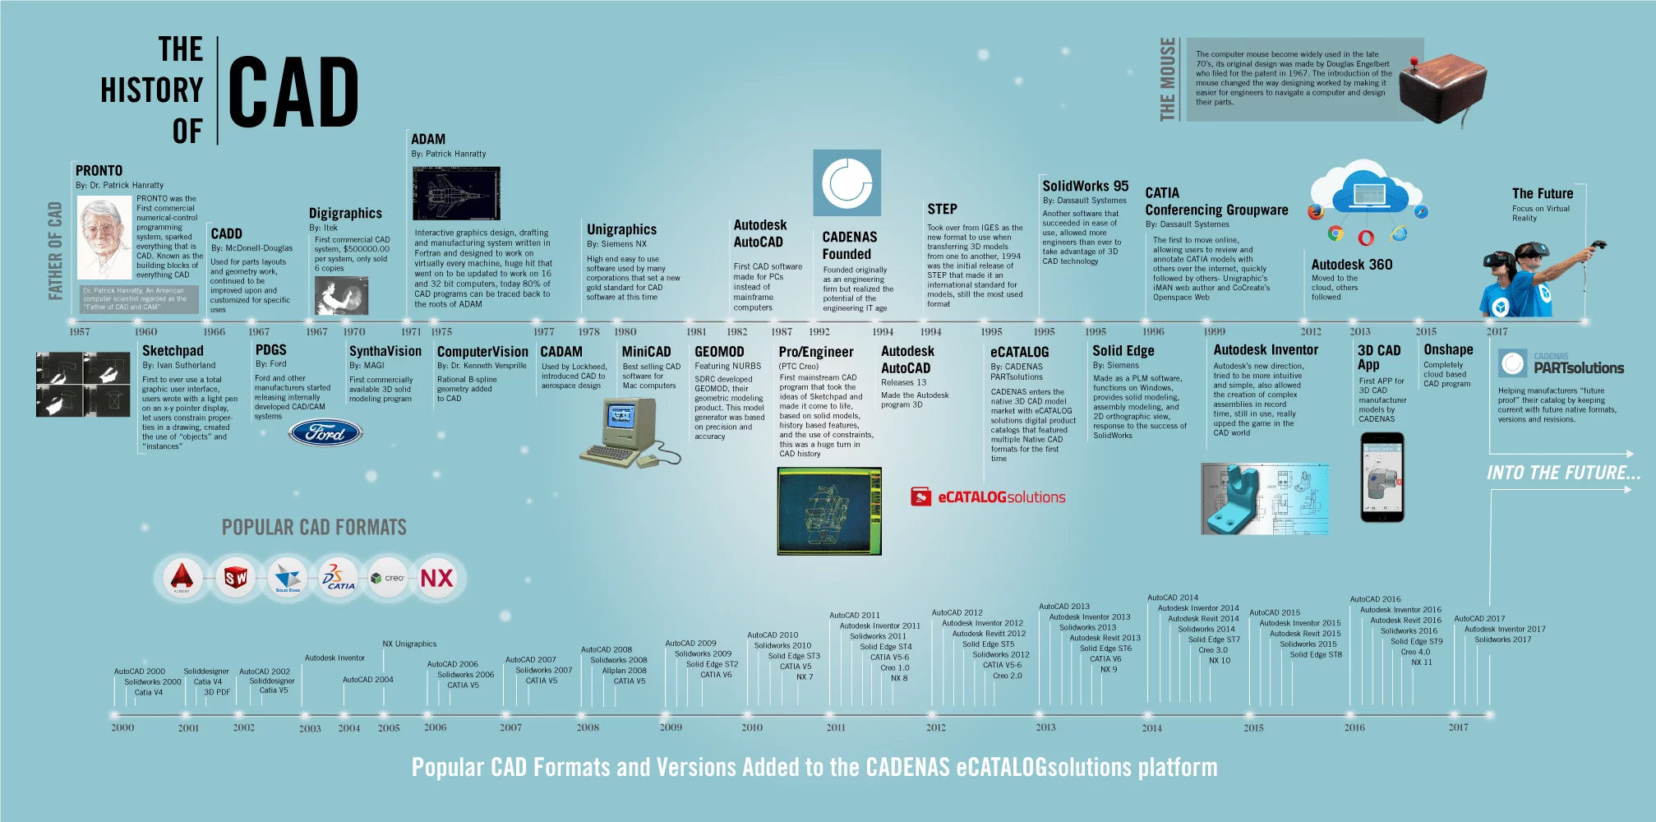
Notes:
Major events in the development of CAD technology
Pronto (Program for Numerical Tooling Operations). – First commercial numerical-control programming language/ system.
In 1960s: Sketch Pad created by Dr. Ivan Sutherland at MIT was a new step forward in human-machine interaction and was a breakthrough in computer graphics in general. The most important advances are the introduction of a graphical user interface. The GUIA graphical interface allows users to interact with the computer through visual aids (icons). This contradicts the more traditional computer interaction method with text and object-oriented programming.
In 1970s: The introduction of Automated Drafting and Machining (ADAM) is another important step forward. ADAM (Automated Drafting and Machinery) is an interactive graphics system written in Fortran, designed to work on virtually all mainframe computers. Approximately 90% of today’s commercial drafting programs can be traced back to ADAM.
In 1980s: Autodesk/ Auto CAD, the first piece of 2D system CAD software released on PC, has received major software sales.
Solid modelling is a major development in CAD in the 1980s.
Pro/Engineer was the mainstream 3D modelling software released based on solid geometry and feature-based parametric techniques.
In 1990s: SolidWorks 95 by Dassault Systems for Windows was introduced. The software allowed more. Engineers to take advantage of 3D CAD technology.
In 21st century: Important trends. Include: Standardisation of software so different packages can share data, greater sophistication of visual representation, and greater integration of modelling and testing applications.
The future of CAD
CAD in the cloud
VR and AR
Full virtual prototyping
Additive Manufacturing
https://ufo3d.com/types-of-3d-modeling-different-industries/
https://www.scan2cad.com/blog/cad/cad-product-design/
https://partsolutions.com/60-years-of-cad-infographic-the-history-of-cad-since-1957/
https://medium.com/technical-illustration/evolution-of-cad-from-light-pens-to-synchronous-technology-549cc8eef5d0
https://slidetodoc.com/major-events-in-the-development-of-cadcam-technology/
CAD is in constant evolution, bringing updates and new features with every new version of a particular tool.
Image source:
https://partsolutions.com/wp-content/uploads/2017/09/The-history-of-CAD_CADENAS_R3.png

Slide 14
Who uses CAD?
CAD software is used by engineers, architects, designers and artists.
To produce detailed designs and technical drawings of real-world products.
To create artistic freedom designs that do not need to work mechanically, be functional or fit to a real-world device.
Notes:
CAD is used by engineers, architects, artists and designers to produce detailed designs and technical drawings.
The use of CAD design software falls into two categories. CAD software is usually used when creating industrial objects such as mechanical objects. On the other hand, some CAD software enables more artistic freedom as designs do not need to work mechanically, be functional or fit to a real-world device. Historically, 3D modelling software has been used in film animations and video games to make organic designs. However, it can also be used to create 3D printable models.

Slide 15
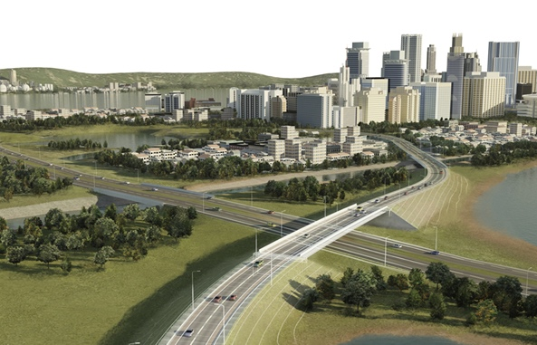
CAD Applications
Almost everything all around us today has been built with CAD. There’s CAD software for almost every professional sector with specialized features and tools for each one, making it widely applicable.
Engineering
AutoCAD Civil 3D
CHEMCAD
HyDraw CAD
SolidWorks
Civil Engineering
Infrastructure, buildings, damns and bridges.
Chemical Engineering
Process design and analysis of chemical plants and power station.
Electrical Engineering
Circuits, electrical devices and telecommunications networks.
Mechanical Engineering
Mechanical components and systems.
Notes:
Almost everything all around us today has been built with CAD.
CAD is extensively used in the design of tools and equipment required in the engineering and manufacturing process as well as in the construction domain. Each of these industries has specific purposes for using 3D models.
Chemical engineering: Design and managing of large-scale plant processes and conditions. CAD software is used for the creation of plans, specifications and analyses for new plants or plant modifications.
Civil engineering: Design and construct public and private works such as infrastructure, buildings, bridges.
Electrical engineering: Design, develop and test circuits, electrical devices and telecommunications networks.
Mechanical engineering: Design mechanical components and assemblies to fit their strict technical specifications, perform simulations.

Slide 16
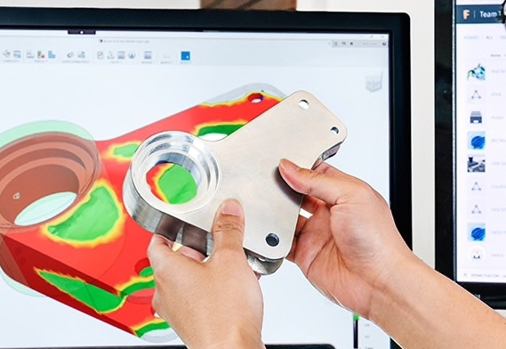
CAD Applications
AutoCAD Architecture
Fusion 360
TUKATECH
MAYA
Architecture
Planning and design of 2D plans and 3D designs, virtual tours, evaluation of cost and risk management.
Product Design
Design, develop and simulate product components and assemblies for manufacture.
Fashion Design
Fashion illustrations, technical drawing pattern-making, virtual sampling, real-life virtual fit sessions, fabric and trims library.
Entertainment Industry
Film and television, video production, game design and development.
Notes:
CAD is also largely used in architecture, product design, followed by fashion and game design industry.
Architecture is one of the most demanding disciplines when talking about CAD; there are so many elements involved during the design of a project that one almost needs software support. (https://www.scan2cad.com/blog/cad/industries-use-cad-architecture/)
Fashion design: https://www.sculpteo.com/en/3d-learning-hub/3d-printing-software/best-cad-fashion-design-software/
https://www.suuchi.com/5-fashion-cad-solutions-that-could-make-your-fashion-design-process-easier/
Entertainment industry (Film and television): CAD software is used for storyboarding and character design, development and inclusion of motion graphics.
Game Design: CAD software is used in high and low resolution modeling, as well as in animation, motion capture, lighting and 3D data transfer.
(https://www.indiacadworks.com/blog/how-the-entertainment-industry-uses-cad-computer-aided-design/)
Software: https://www.autodesk.com/industry/media-entertainment/game-design-and-development maya
https://www.scan2cad.com/blog/cad/how-engineers-use-cad/#history
https://all3dp.com/2/what-is-cad-design-simply-explained/
Image sources:
Architecture: AutoCAD Architecture - https://www.autodesk.com/products/autocad/included-toolsets/autocad-architecture
Product Design: Fusion360 - https://www.autodesk.eu/products/fusion-360/overview
Fashion Design: Tukatech - https://www.prnewswire.com/news-releases/tukatech-introduces-worlds-first-fully-automatic-pattern-making-system-300889148.html
Entertainment Industry: Maya - https://www.autodesk.com/products/maya/overview?term=1-YEAR&tab=subscription

Slide 17
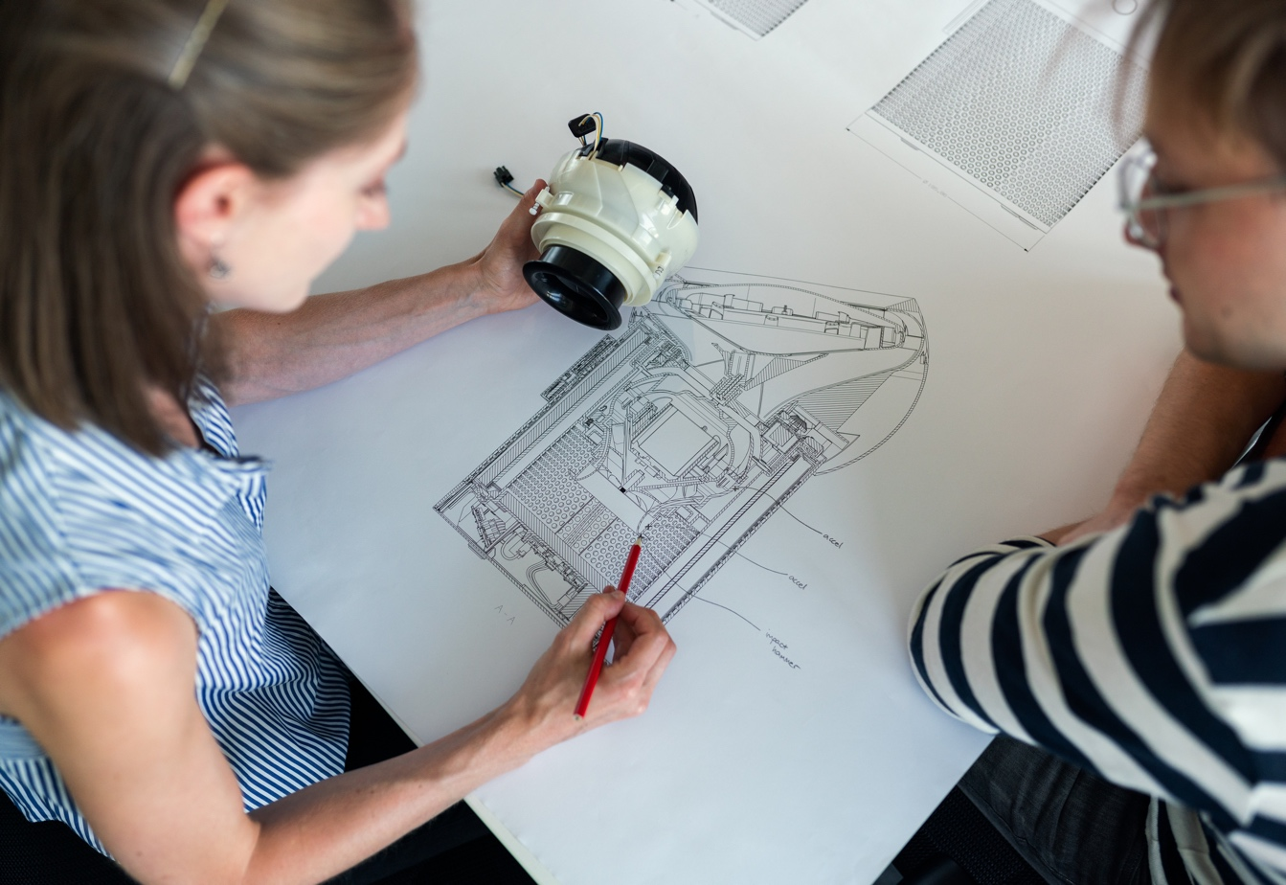
CAD in Product Design and Development
Let’s take a look at traditional versus modern approaches to product development process.
Notes:
Apart from to assist in the creation, modification, analysis or optimisation of a design.
perform structural, thermal, modal, fatigue, motion, and mold analysis, toggling between steady-state and transient simulation
create multibody modeling, and exclude construction bodies from BOM information and mass property calculations
run topology optimization studies based on both engineering requirements as well as manufacturing methods
Photo realistic rendering (Photorealistic Renderings for Marketing, Kickstarter Campaign Content, Digital Mock-ups for Investor Presentations, e-Commerce Images) (Show examples) rendering and animation capabilities to better visualise product design.

Slide 18
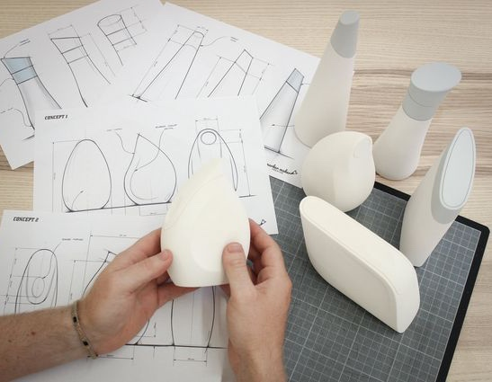
Traditional Approach
“Design, Build, Test”
A physical prototype is usually constructed to prove design concepts, evaluate design alternatives, test product manufacturability, and often just to present a product.
Notes:
Time consuming
Expensive
Traditional product development models are unable to keep up.
https://www.pinterest.co.uk/pin/384705993175915240/

Slide 19
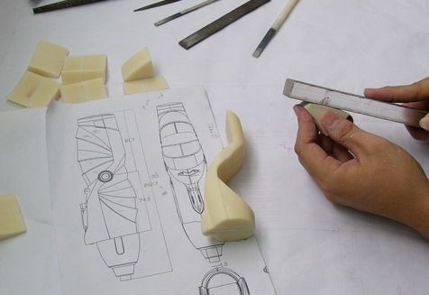
2D pencil-and-paper sketching
↓
3D soft model (clay, foam, wood, paper)
↓
Simplified engineering analysis
↓
Physical mock-up
↓
Physical testing and evaluation
↓
Traditional media for design review
Notes:
Hand sketching, schematics, blueprints, exploded diagrams
Traditional materials: Wood, paper, clay, epoxy, foam
https://www.pinterest.co.uk/pin/40391727900268160/
https://i.pinimg.com/originals/d4/c0/cc/d4c0ccbba190e9dd33cd7be017d76064.jpg

Slide 20
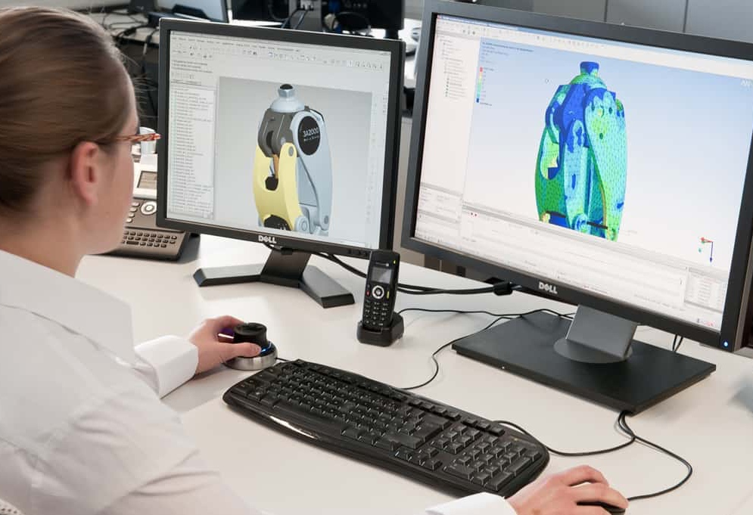
Modern/ Digital Approach
“Model, Analyse, Build”
A set of digital prototypes are constructed to visualize design concepts, evaluate design alternatives, test product manufacturability, and simulate human and product interaction.
Notes:
Image source:
https://www.cadcam.org/blog/how-cad-computer-aided-design-has-evolved-over-the-years/

Slide 21
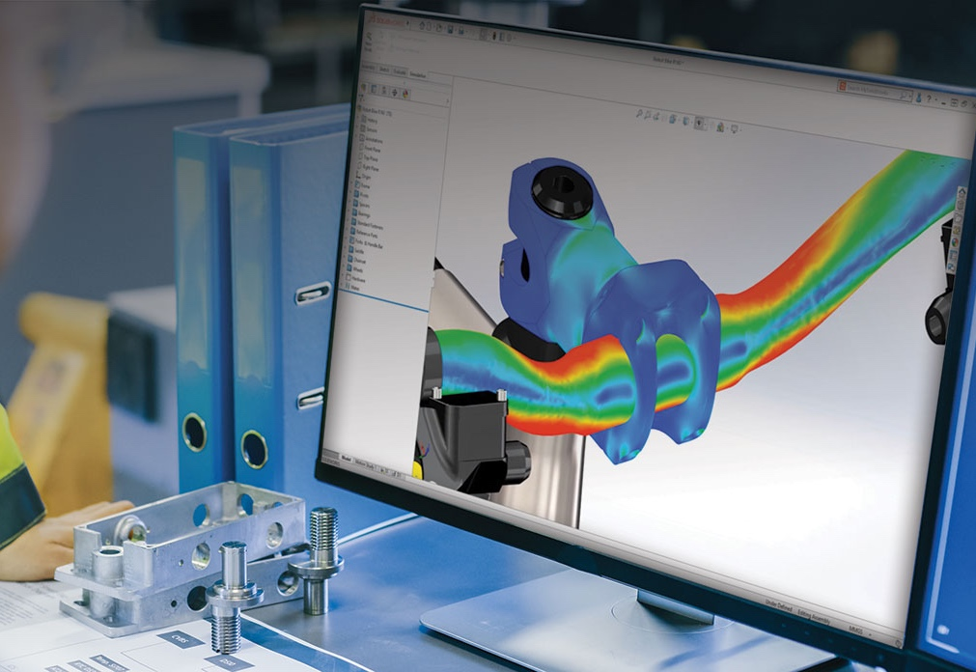
Digital sketching
↓
Digital sculpting
↓
3D CAD model
↓
Integrated engineering analysis (Computer Aided Engineering (CAE) – Finite element analysis, computational fluid dynamics, multibody dynamics)
↓
Virtual prototypes
↓
Simulation for testing and evaluation
↓
Digital models for tooling design and digital manufacturing
Notes:
The move from drafting with paper and pencils to creating designs digitally on screen (Virtual product development) has vastly increased efficiency and reduced waste.
Digital sculpting is a method of 3D modelling that allows an artist to interact with digital objects as if they were made of clay, shaping them through pulling, pushing and smoothing.
Computer-aided engineering (CAE) is the broad usage of computer software to aid in engineering analysis tasks. It includes finite element analysis (FEA), computational fluid dynamics (CFD), multibody dynamics (MBD), durability and optimization.
perform structural, thermal, modal, fatigue, motion, and mold analysis, toggling between steady-state and transient simulation
create multibody modeling, and exclude construction bodies from BOM information and mass property calculations
run topology optimization studies based on both engineering requirements as well as manufacturing methods
Image source:
https://www.solidworks.com/product/solidworks-simulation

Slide 22
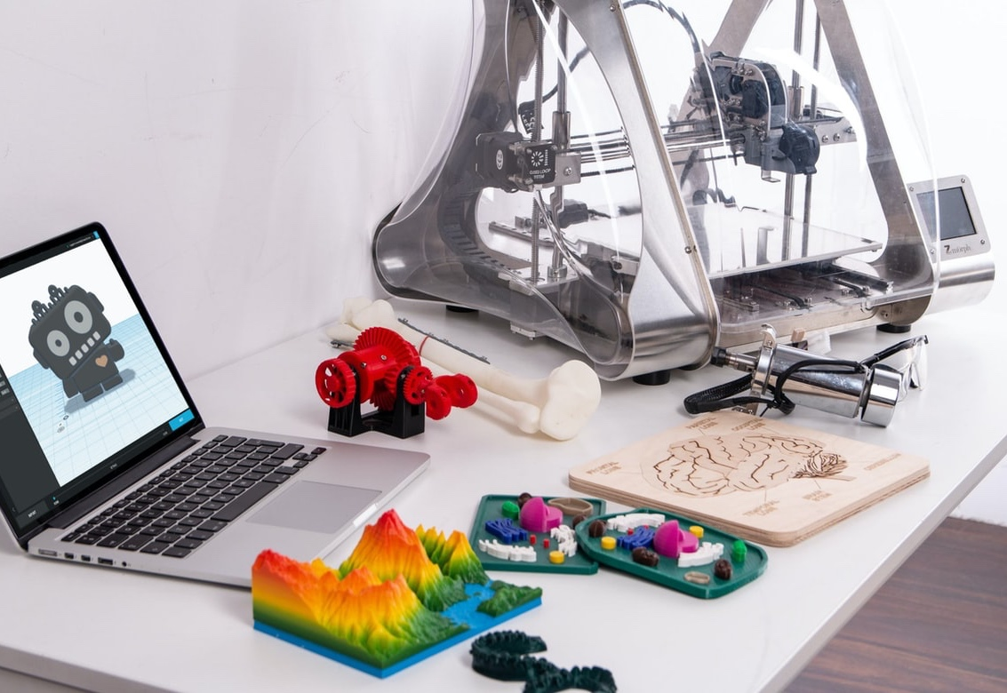
CAD in Product Design and Development
Proof of Concept
Product life cycle and management
Prototyping and manufacturing (i.e., 3D Printing, CNC Machining, laser cutting and engraving)
3D rendering and animation to better visualise product design.
Notes:
Apart from assisting the creation, modification, analysis or optimisation of a design prior to production.
CAD is often used for:
Proof of Concept
3D photo realistic rendering and animation to better visualise product design (Photorealistic Renderings for Marketing, Kickstarter Campaign Content, Digital Mock-ups for Investor Presentations, e-Commerce Images)
Prototyping and manufacturing (i.e., 3D Printing, CNC Machining, laser cutting and engraving)
Image source:
https://unsplash.com/photos/Fo-HQUlRGkU

Slide 23
3D Rendering
3D rendering is a creative process that uses computer graphics to convert 3D models into photorealistic or non-photorealistic images.
3D rendering gives the final appearance to the models and animation with visual effects such as lighting, shading, texture-mapping, shadows, reflections and motion blurs. The types of rendering range from distinctly non-realistic wireframe rendering through polygon-based rendering, to more advanced techniques such as scanline rendering, ray tracing, or radiosity. Rendering may take from fractions of a second to days for a single image or frame.
Many 3D modelling software now offers advanced rendering and animation capabilities to better visualise product design, such as:
SolidWorks
Alias
3DS Max
Maya
and many more…
Notes:
3D rendering is a creative process that uses computer graphics to convert 3D models into photo realistic or non photo realistic images.
Formative assessment format: Multiple choice
What are the benefits of 3D product rendering?
Create stunning product marketing assets that were previously impossible using photography
Bring life to 3D models
Enhance your visual communication through 3D Rendering
Tweak colours and materials for tuning 3D visuals
Make your product design process easier through CGI
Create stunning marketing images with 3D visualisation
Sell your product before it has been produced
These programs can add depth and realism to scenes.
Information sources:
https://www.xo3d.co.uk/product-rendering/
https://www.g2.com/categories/3d-rendering
https://www.autodesk.co.uk/solutions/3d-rendering-software

Slide 24
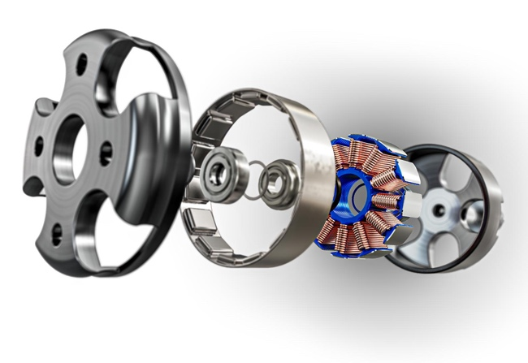
Which of the following is a 3D rendered model?
A.
B.
C.
D. All the above
Answer: D. All the above
Notes:
Formative assessment format: Multiple choice
Image source:
D’Addario rolled strap renders: https://www.xo3d.co.uk/Our-Work/daddario-auto-lock-guitar-strap/#
Paymentsense Dojo card payment machine: https://www.pinterest.co.uk/pin/862931978607004638/
Exploded view: https://www.xo3d.co.uk/product-rendering/

Slide 25
CAD programs are able to output files for which manufacturing methods?
3D Printing
CNC machining
Laser cutting and engraving
All the above
Answer: D. All the above
Notes:
Formative assessment format: Multiple choice

Slide 26
What are the advantages and disadvantages of CAD?
Let’s look at some of the key benefits and drawbacks of integrating CAD usage in product development.

Slide 27
Advantages
Visualisation
Ability to create and visualise 2D drawings and 3D models, reducing the need for multiple physical prototypes, lower production costs and speed up the design process between the initial concept and end- product.
Higher Accuracy and Improve Design Quality
Digital representation in CAD is very close to real life, making it accurate up to a certain level compared to traditional approaches. The use of CAD allows designers and engineers design with perfect accuracy and precision.
Optimisation
CAD software helps to detect an error, diagnose the problem, solve it during the design process, run simulations to test how different parts and materials would perform under certain conditions and real-world variables.
Realisation
Ability to create realistic virtual prototypes that resembles what the finished product will look like in the real world.
Notes:
CAD software offers many benefits and solutions that help make the design process easier. Studies have proven that integrated CAD usage allows product development firms to meet their goals more efficiently. Product development time, product quality, and productivity all improve when using CAD, which translates to reduced manufacturing and product costs.
Visualisation: Before CAD, designers were forced to draw everything by hand. If they wanted to alter the design, they would have to draw the entire thing again. CAD software allows designers to visualize their designs and test them against real-world variables.
Increase the productivity of the designer or engineer
Speed up the design process
Explore design ideas
Higher accuracy and quality design: Accuracy is essential when creating the final design and specification, especially when creating large volumes or high cost parts.
Optimisation: Any any error will potentially add a huge costs to the design process.
https://www.cadcrowd.com/blog/the-advantages-of-cad/

Slide 28
Advantages
Documenting the Design
CAD software is excellent at documenting all aspects of a design. The measurements, angles and dimensions of components and subassemblies are all conveniently recorded and saved for future use.
Revise and Reuse Design
Designers can alter their designs and make as many changes as needed. Mistakes can be easily fixed through the saved revision histories. New versions of the design can be produced easily by editing the existing design.
Production-ready Design
Virtual models created in CAD software can be converted directly into the appropriate file format for manufacturing into a finished product.
Simplified Sharing
CAD software with real-time design views and collaborative workflows for interactive design reviews and concurrent design edits makes collaborating easy, even for remote teams. Team members can share, review, simulate, modify designs easily and send it to another.
Notes:
Production-ready design: 3D Printing, CNC machining or laser cutting and engraving.
Simplified sharing: If you’re a part of a big team, you know how valuable sharing is. They can view the design history to see exactly what was done and how.
Why 3D CAD modelling?
3D modelling helps to get into the perspective of ‘How the product would look in real-time before manufacturing’
It gives you a better understanding of the product size, shape, bounding box and packaging
It is precise and accurate – enables to quantify the sizing, clearances and fit in the assembly with ease
It helps to make the product cost-effective and market in time
Assemblies and Mechanism can be validated, simplified and enhanced easily
Before prototyping, mechanicals, fitments, spacing and cosmetics errors can be easily identified and rectified
Cross-section view, exploded view, illustrations, SOP, DFMA can be performed
It is effective and efficient to deliver the product 45% faster than the conventional methodologies
Improves product development cycle communication, reduces errors and cycle time
It documents the components with manufacturing drawings, Bill of materials, and Material requirements.
https://graphlertech.com/what-is-3d-cad-and-why-is-it-used/

Slide 29
40%↑
30%↓
Some
Statistics
30%↓
Increase in
operation efficiency
Reduction in
design time
57%↓
Reduction in
prototype costs
Reduction in
time to market
PTC - https://www.ptc.com/en/technologies/cad
Notes:
Most users experience an overall increase in operational efficiency while seeing a decrease in design time, prototype costs, and time to market.
https://www.ptc.com/en/technologies/cad

Slide 30
Disadvantages
Limiting Creativity and Innovation
Traditional sketching on paper “remains a basic tool for speeding up visual problem solving” and help develop a designer’s capacity for creative thinking. Those who design exclusively using CAD may find themselves more constrained to certain ways of thinking and drafting.
Skills of the Designer
CAD are tools for a designer to use to create a design. Like all tools, they are only as useful as the one handling them. While a computer can tell you what a design will look like, the user is the one who makes the decision, which inevitably affects function.
Time
The use of CAD takes time. Properly creating and executing designs comes with a certain amount of overhead, including the time associated with training.
Notes:
Restrict creativity and Innovation: Some have noted that the old method of drafting via sketching on paper “remains a basic tool for speeding up visual problem solving”. Sketching can help develop a designer’s capacity for creative thinking and enable them to create innovative solutions to the problems they aim to tackle.
Skills of the Designer: CAD software also cannot tell you which design is more aesthetically pleasing, and in some industries, that overrides function.
Time: The creation of 3D models tends to be a more complex and time-consuming process which require various specialty training and years of experience.
https://www.cadcrowd.com/blog/the-advantages-of-cad/

Slide 31
Disadvantages
Designing in a Virtual Workspace
When designing in the virtual workspace, there is a degree of separation from the physical object that is implied. Designing virtually allows the user to create perfection without concerning themselves with real-world constraints.
Licensing
Higher-end CAD software typically come with high prices, whether subscription-based or one-time fees. The main exception to this is if they are being used for educational purposes.
Hardware
CAD tools often require powerful and expensive hardware to perform optimally. Power cuts and viruses can cause problems for the computerised system.
Notes:
Skills of the Designer: CAD software also cannot tell you which design is more aesthetically pleasing, and in some industries, that overrides function.
Licensing: SolidWorks - £2888 one-time fee or £936 annual subscription-based fee; AutoCAD - £3033 one-time fee or £1214 annual subscription-based fee.
https://www.cadcrowd.com/blog/the-advantages-of-cad/

Slide 32
Types of 3D CAD modelling
Now, let’s look at the three major types of 3D modelling.

Slide 33
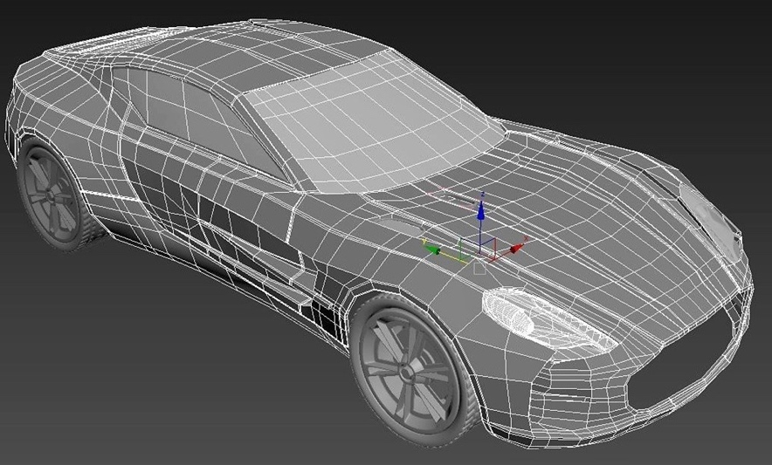
Types of 3D CAD Modelling
Solid Modelling
Wireframe Modelling
Surface Modelling
Solid modelling works with three-dimensional shapes which involve manipulating and combining blocks.
Wireframe modelling represents shapes as a network of vertices.
Surface modelling defines the shape and curvature by depending upon the guiding lines.
Notes:
3D CAD can be subdivided as follows: Solid modelling, wireframe modelling and surface modelling.
Solid modelling: https://graphlertech.com/what-is-3d-cad-and-why-is-it-used/
Image source:
Solid modelling: https://learnmech.com/what-is-3d-solid-modelling-solid-modeling-methods/
Wireframe modelling: https://techterms.com/definition/wireframe
Surface modelling: https://all3dp.com/2/surface-modeling-cad-simply-explained/

Slide 34
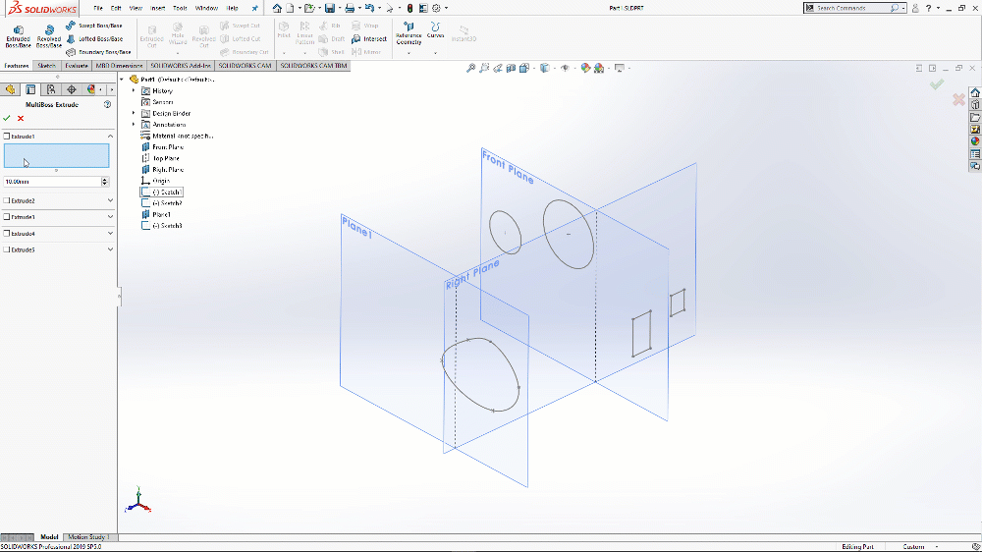
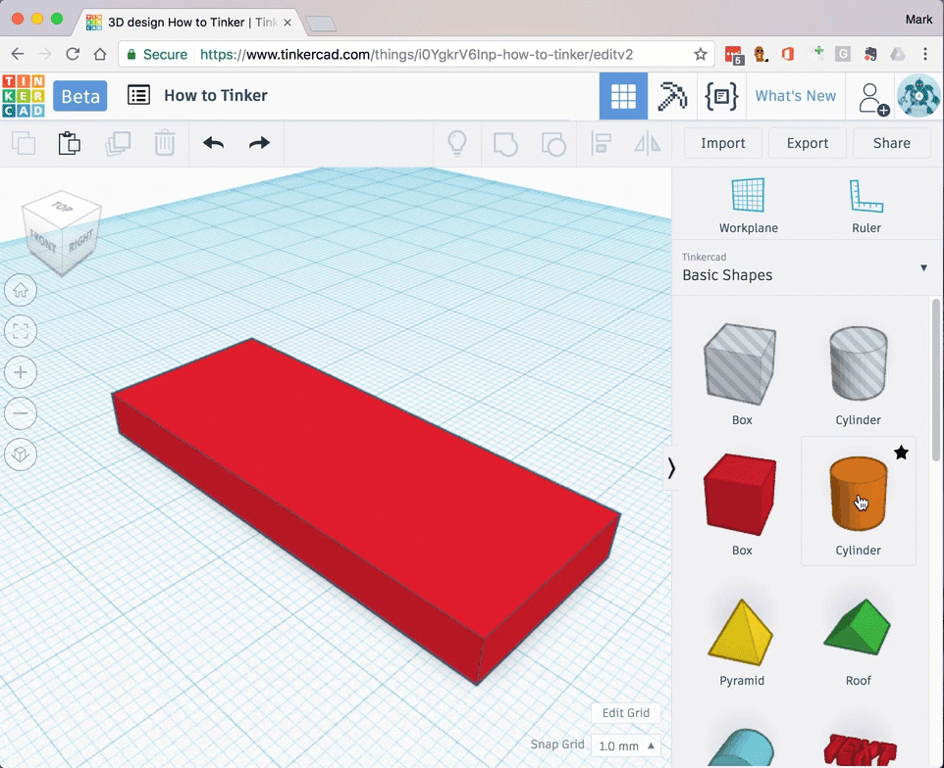
Solid Modelling
Solid modelling works with three-dimensional (3D) shapes which involve manipulating and combining building blocks.
Some software begin with 2D portrayal sketches that are then expelled to deliver a 3D figure.
Some software add or subtract solid over solid like building blocks to create more intricate figures.
SolidWorks
TinkerCAD
Particularly helpful when flat surfaces or basic bends of consistent radii are included.
Lends itself very well to exact measurements and angles.
No extensive training required and is very user-friendly.
Computational prerequisites are lower.
Notes:
Image source:
https://www.reddit.com/r/SolidWorks/comments/hs5imb/create_single_solidworks_extrude_from_multiple/
https://cuperman007.github.io/codeclub/learn/tinkercad/tutorials/beginner/create-a-keyring/
Software Examples:
TinkerCAD, FreeCAD, Sketch Up, SolidWorks, Autodesk Fusion 360.

Slide 35
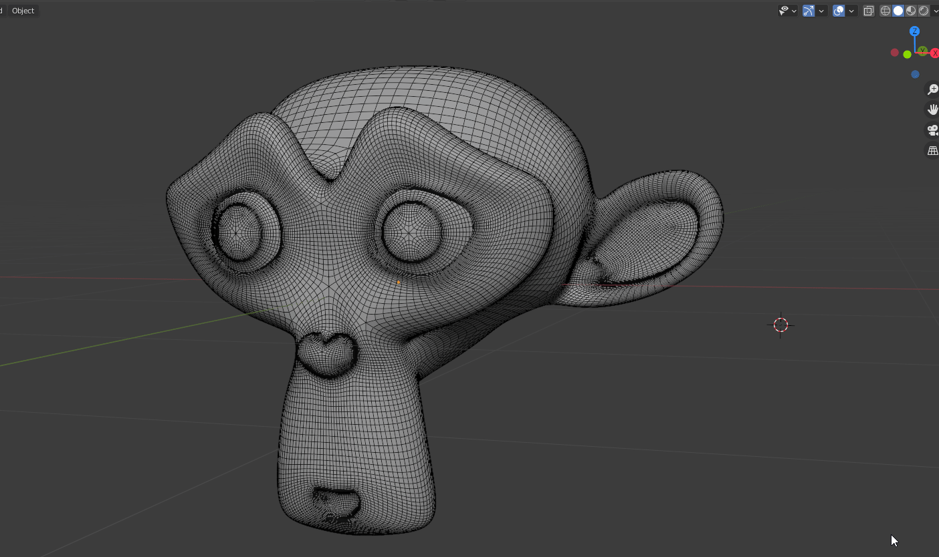
Wireframe Modelling
Wireframe modelling was the first to be utilized to model 3D figures. Each geometrical face is made out of minimum three vertices and every vertex can be important for at least one appearance. The size and state of things are altered by changing the position of every vertex.
A 3D wireframe model is a skeletal representation of an object.
Blender
It consists of various points, arcs, lines, circles, and curves to cleanly denote object edges and depth.
The user can view reference geometry of a 3D solid, mesh, and surface modelling.
Notes:
This method was the first to be utilized to model 3D figures, at that point having moderately low polygon counts, making figures to some degree blocky.
https://techterms.com/definition/wireframe
https://it-s.com/what-is-3d-wireframe-modeling/
Software Examples:
Blender, Autodesk Maya, 3DS Max and Cinema 4D.
Image source:
https://blender.community/c/rightclickselect/N6gbbc/?sorting=hot

Slide 36
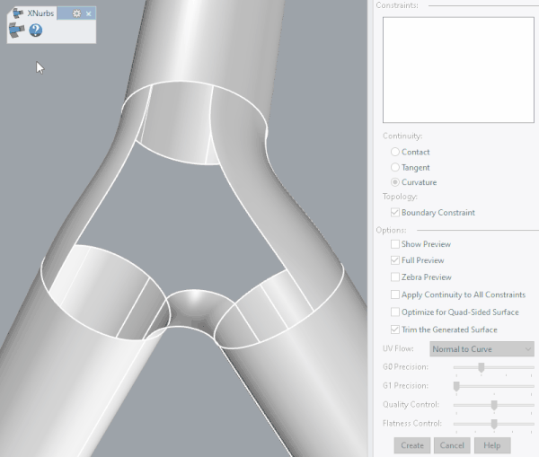
Surface Modelling
Surface modelling relies on guiding lines to define the shape and curvature of a part. The software then calculates a smooth surface that connects the guiding lines. Some programs make use of control points and control panels where the desired surface follows the planes tangentially.
Alias
The user can actually see the entire surface points beneath which the solid interiors are present.
Surface modelling tools let the user build one face at a time to control the exact contour and direction of that face.
Notes:
Surface modelling tools build one face at a time. This enable user to control the exact contour and direction of that face.
https://flippednormals.com/downloads/hard-surface-modeling-tutorial/
https://graphlertech.com/surface-modelling-3d-cad/
Software Examples:
CATIA, Alias, Rhino
Image source:
https://forums.autodesk.com/t5/alias-forum/developing-xnurbs-module-for-alias/td-p/9528435

Slide 37
Advantages
Solid Modelling
Wireframe Modelling
Surface Modelling
A solid model is a more complete representation than wireframe and surface model.
It provides more topological information in addition to the geometrical information which helps to represent the solid unambiguously.
It is conceivable to accomplish more complex surfaces and bends contrasted with solid modelling.
Provides the finesse for more complex forms.
Particularly helpful for creating highly professional applications that demand complex and smooth surface appearance, and seamless integration.
Can achieve shapes that would be nearly unattainable with the other two methods.
Notes:
Within CAD, there are three main types of 3D modelling
Solid modelling
Surface modelling
Wireframe modelling- Polygon-based modelling (Meshing)
Disadvantages: Solid modelling: The basic building blocks of solid modelling are too obtuse for some applications.

Slide 38
Disadvantages
Solid Modelling
Wireframe Modelling
Surface Modelling
The basic building blocks of solid modelling are too obtuse for some applications.
High realism in the representation of natural shapes is practically difficult to accomplish.
Users require formal training.
High resolution will require a huge number of polygons and computational power.
It is a complex form of 3D modelling therefore, requires a higher level of training and expertise on the part of the designer.
The steps in surface modelling are not parametric and hence it can be hard to make design changes.
Notes:
Disadvantages: Solid modelling: The basic building blocks of solid modelling are too obtuse for some applications.
Surface modelling: It is a complex form of 3D modelling which requires a higher level of training and expertise on the part of the designer. It is rather difficult to construct.
It is more time consuming in comparison to the other two methods.

